Slide 1

Operating Systems: Internals
and Design Principles
Chapter 8 Virtual Memory
Seventh Edition
William Stallings
Notes:
“Operating Systems: Internal and Design Principles”, 7/e, by William Stallings, Chapter 8 “Virtual Memory”.
1

Slide 2
Chapter 8 Virtual Memory
8.1 Hardware and Control Structures
8.2 Operating System Software
8.3 UNIX and Solaris Memory Management
8.4 Linux Memory Management
8.5 Windows Memory Management
8.6 Android Memory Management

Slide 3

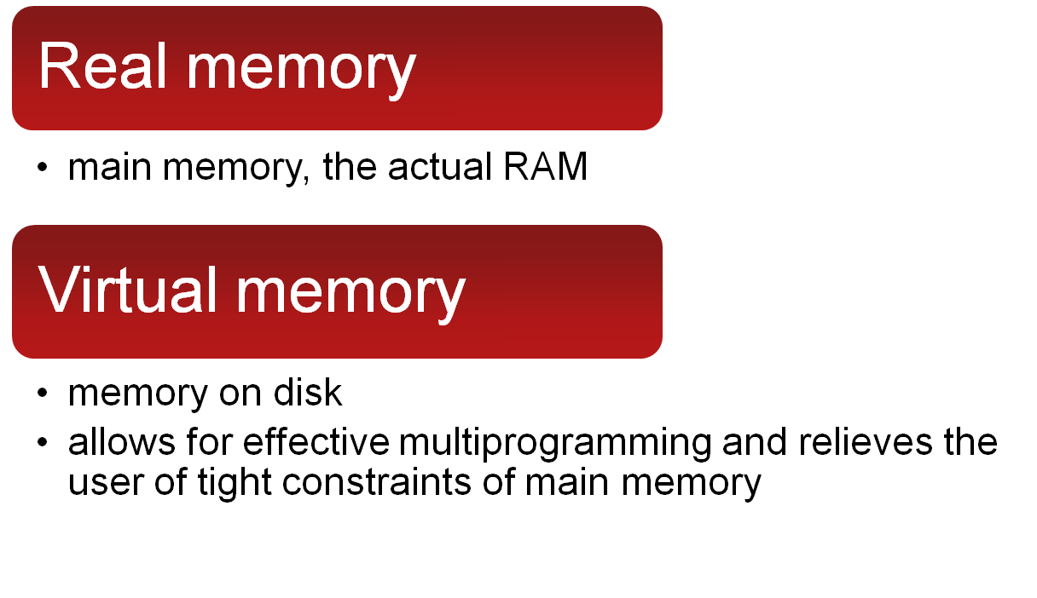
8.1
https://www.youtube.com/watch?v=qcBIvnQt0Bw
Main memory combined with swap space on disk
https://www.youtube.com/watch?v=qlH4-oHnBb8
Notes:
Because a process executes only in main memory, that memory is referred to
as real memory . But a programmer or user perceives a potentially much larger memory—
that which is allocated on disk. This latter is referred to as virtual memory .
Virtual memory allows for very effective multiprogramming and relieves the user
of the unnecessarily tight constraints of main memory.
3

Slide 4
Hardware and Control Structures
A process may be broken up into a number of pieces that don’t need to be contiguously located in main memory during execution
All memory references are logical addresses that are dynamically translated into physical addresses at run time
If these two characteristics are present, it is not necessary load whole process into physical memory during execution
Notes:
Comparing simple paging and simple segmentation, on the one hand, with fixed and
dynamic partitioning, on the other, we see the foundation for a fundamental breakthrough
in memory management. Two characteristics of paging and segmentation
are the keys to this breakthrough:
1. All memory references within a process are logical addresses that are dynamically
translated into physical addresses at run time. This means that a process may be swapped in and out of main memory such that it occupies different
regions of main memory at different times during the course of execution.
2. A process may be broken up into a number of pieces (pages or segments) and
these pieces need not be contiguously located in main memory during execution.
The combination of dynamic run-time address translation and the use of
a page or segment table permits this.
Now we come to the breakthrough. If the preceding two characteristics are
present, then it is not necessary that all of the pages or all of the segments of a process
be in main memory during execution. If the piece (segment or page) that holds the
next instruction to be fetched and the piece that holds the next data location to be
accessed are in main memory, then at least for a time execution may proceed.
4

Slide 5
The birth of virtual memory
To eliminate the requirement that all pages of a process reside in main memory simultaneously.
All the pages of a process are maintained on disk. When a process is executing, only some of its pages are in main memory. If reference is made to a page that is not in main memory, the memory management hardware detects this and arranges for the missing page to be loaded into Physical MEM.
Such a scheme is referred to as virtual memory
Notes:
More processes may be maintained in main memory.
Because we are only going to load some of the pieces of any particular process, there is room for more processes.
This leads to more efficient utilization of the processor because it is more likely that at least one of the more numerous processes will be in a Ready state at any particular time.
2. A process may be larger than all of main memory.
Without the scheme a programmer must be acutely aware of how much memory is available.
If the program being written is too large, the programmer must devise ways to structure the program into pieces that can be loaded separately in some sort of overlay strategy.
With virtual memory based on paging or segmentation, that job is left to the operating system and the hardware. As far as the programmer is concerned, he or she is dealing with a huge memory, the size associated with disk storage.
The operating system automatically loads pieces of a process into main memory as required.
5

Slide 6

Implications
More processes may be maintained in main memory
only load in some of the pieces of each process
with so many processes in main memory, it is very likely a process will be in the Ready state at any particular time
➔ Higher Degrees of Multiprogramming
The address space of a process may be larger than size of main memory
https://www.youtube.com/watch?v=DFZZKINz1cI
Notes:
More processes may be maintained in main memory.
Because we are only going to load some of the pieces of any particular process, there is room for more processes.
This leads to more efficient utilization of the processor because it is more likely that at least one of the more numerous processes will be in a Ready state at any particular time.
2. A process may be larger than all of main memory.
Without the scheme a programmer must be acutely aware of how much memory is available.
If the program being written is too large, the programmer must devise ways to structure the program into pieces that can be loaded separately in some sort of overlay strategy.
With virtual memory based on paging or segmentation, that job is left to the operating system and the hardware. As far as the programmer is concerned, he or she is dealing with a huge memory, the size associated with disk storage.
The operating system automatically loads pieces of a process into main memory as required.
6

Slide 7

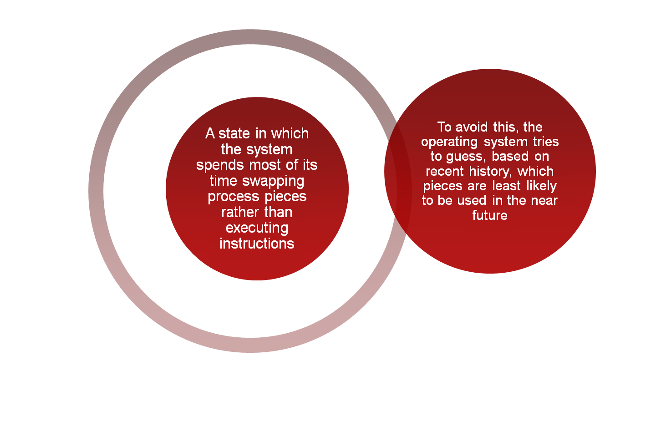
Notes:
To understand what the key issue is, and why virtual memory was a matter
of much debate, let us examine again the task of the operating system with respect
to virtual memory. Consider a large process, consisting of a long program plus a
number of arrays of data. Over any short period of time, execution may be confined
to a small section of the program (e.g., a subroutine) and access to perhaps only one
or two arrays of data. If this is so, then it would clearly be wasteful to load in dozens
of pieces for that process when only a few pieces will be used before the program is
suspended and swapped out. We can make better use of memory by loading in just a
few pieces. Then, if the program branches to an instruction or references a data item
on a piece not in main memory, a fault is triggered. This tells the operating system
to bring in the desired piece.
Thus, at any one time, only a few pieces of any given process are in memory,
and therefore more processes can be maintained in memory. Furthermore, time is
saved because unused pieces are not swapped in and out of memory. However, the
operating system must be clever about how it manages this scheme. In the steady
state, practically all of main memory will be occupied with process pieces, so that the
processor and operating system have direct access to as many processes as possible.
Thus, when the operating system brings one piece in, it must throw another out. If it
throws out a piece just before it is used, then it will just have to go get that piece again
almost immediately. Too much of this leads to a condition known as thrashing : The
system spends most of its time swapping pieces rather than executing instructions.
The avoidance of thrashing was a major research area in the 1970s and led to a variety
of complex but effective algorithms. In essence, the operating system tries to guess,
based on recent history, which pieces are least likely to be used in the near future.
7

Slide 8
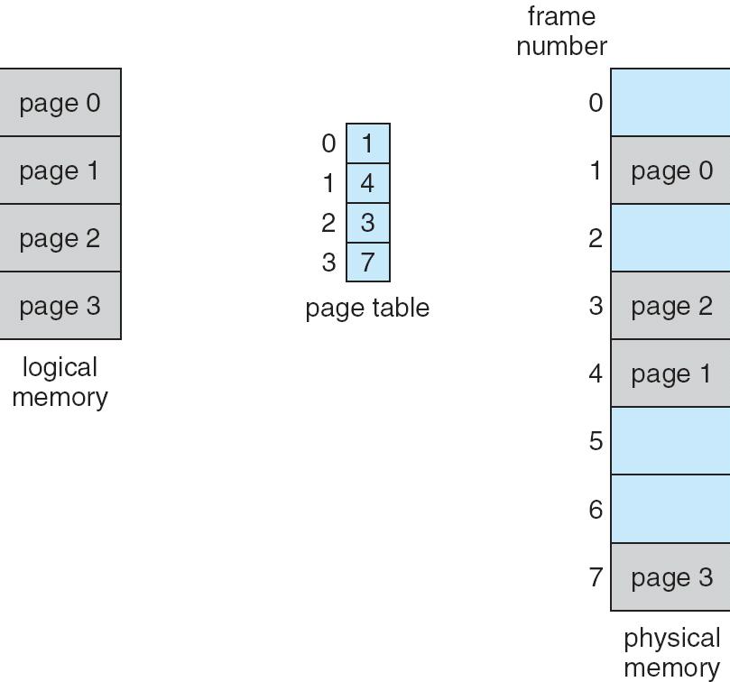
Paging Model of Logical and Physical Memory
https://www.youtube.com/watch?v=6neHHkI0Z0o
Notes:
8

Slide 9
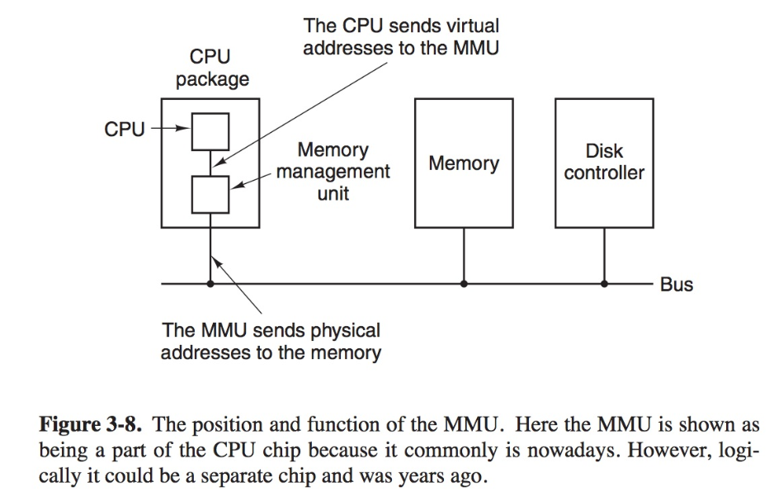

Slide 10
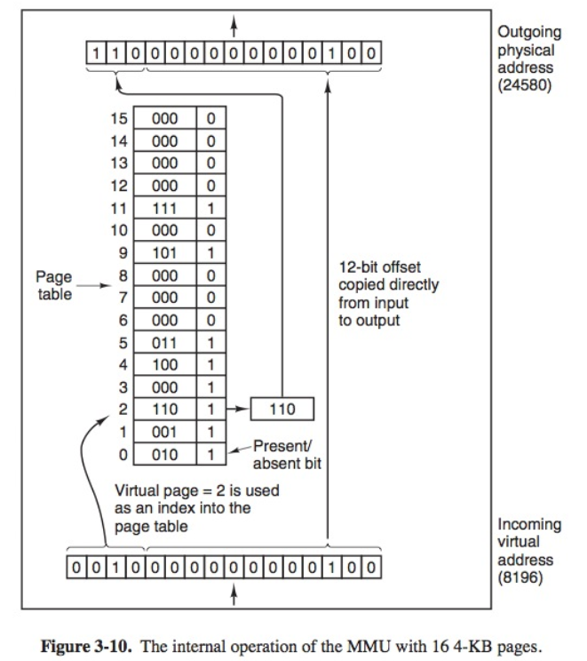

Slide 11
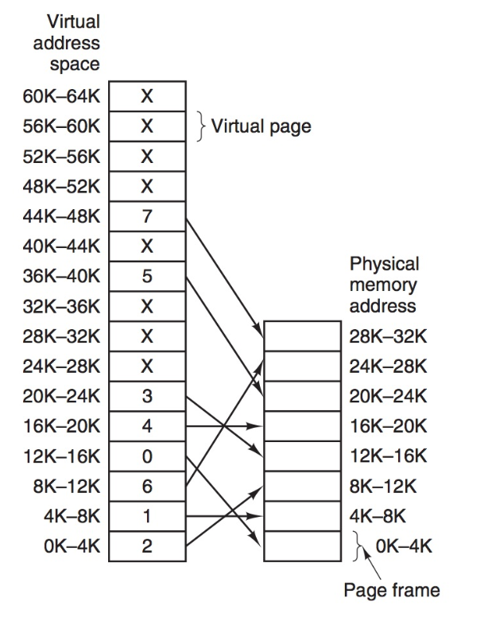
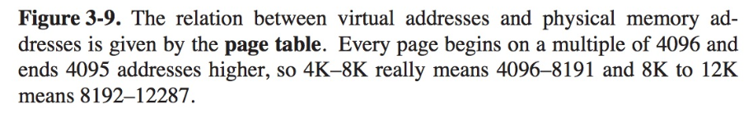

Slide 12
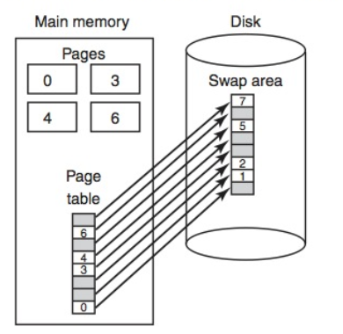

Slide 13
Notes:
With dynamic mapping hardware available, the next logical step was to
eliminate the requirement that all pages of a process reside in main memory simultaneously.
All the pages of a process are maintained on disk. When a process is
executing, some of its pages are in main memory. If reference is made to a page
that is not in main memory, the memory management hardware detects this and
arranges for the missing page to be loaded. Such a scheme is referred to as virtual
memory and is depicted in Figure 2.9 .
The processor hardware, together with the OS, provides the user with a
“virtual processor” that has access to a virtual memory. This memory may be a
linear address space or a collection of segments, which are variable-length blocks
of contiguous addresses. In either case, programming language instructions can
reference program and data locations in the virtual memory area. Process isolation
can be achieved by giving each process a unique, nonoverlapping virtual memory.
Memory sharing can be achieved by overlapping portions of two virtual memory
spaces. Files are maintained in a long-term store. Files and portions of files may be
copied into the virtual memory for manipulation by programs.

Slide 14
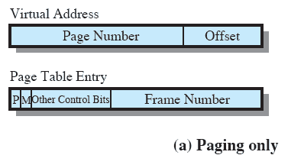
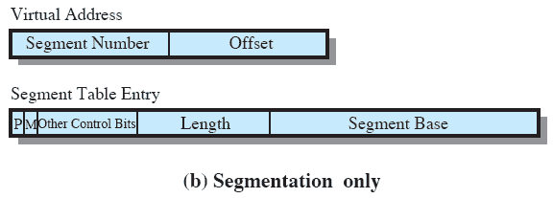
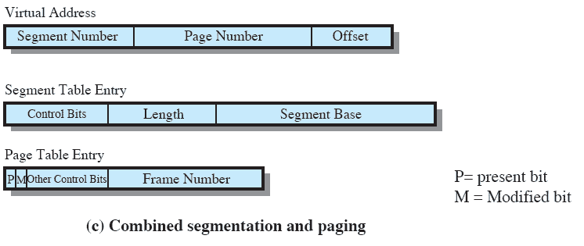
Memory Management Formats
Notes:
Again, it is typical to associate a unique page table with each process. In this case, however,
the page table entries become more complex ( Figure 8.2a ). Because only some of
the pages of a process may be in main memory, a bit is needed in each page table
entry to indicate whether the corresponding page is present (P) in main memory or
not. If the bit indicates that the page is in memory, then the entry also includes the
frame number of that page.
The page table entry includes a modify (M) bit, indicating whether the contents
of the corresponding page have been altered since the page was last loaded
into main memory. If there has been no change, then it is not necessary to write the
page out when it comes time to replace the page in the frame that it currently occupies.
Other control bits may also be present. For example, if protection or sharing is
managed at the page level, then bits for that purpose will be required.
14

Slide 15
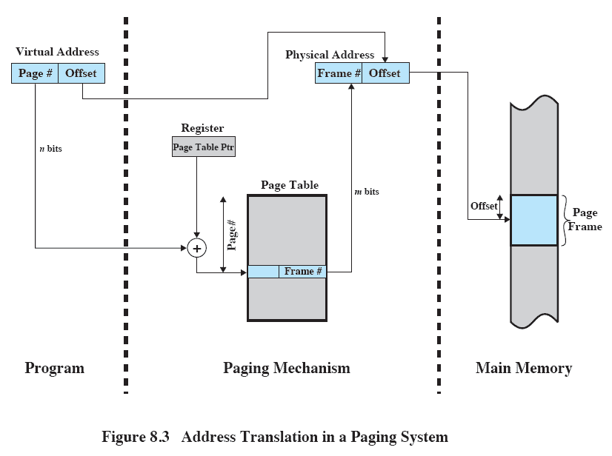
Address Translation
Notes:
PAGE TABLE STRUCTURE The basic mechanism for reading a word from memory
involves the translation of a virtual, or logical, address, consisting of page number
and offset, into a physical address, consisting of frame number and offset, using a
page table. Because the page table is of variable length, depending on the size of the
process, we cannot expect to hold it in registers. Instead, it must be in main memory
to be accessed. Figure 8.3 suggests a hardware implementation. When a particular
process is running, a register holds the starting address of the page table for that
process. The page number of a virtual address is used to index that table and look
up the corresponding frame number. This is combined with the offset portion of the
virtual address to produce the desired real address. Typically, the page number field
is longer than the frame number field ( nm ).
15

Slide 16
Page Table
In any paging system, two major issues must be faced:
1. The mapping from virtual address to physical address must be fast.
2. If the virtual address space is large, the page table will be large.
How to manage page table more efficiently?
What is the size of all page tables in a system?
Where to put them?
https://www.youtube.com/watch?v=28AZ0B-A8Yc
Notes:
The term virtual memory is usually associated with systems that employ paging,
although virtual memory based on segmentation is also used and is discussed next.
The use of paging to achieve virtual memory was first reported for the Atlas computer
[KILB62] and soon came into widespread commercial use.
In the discussion of simple paging, we indicated that each process has its
own page table, and when all of its pages are loaded into main memory, the page table
for a process is created and loaded into main memory. Each page table entry
(PTE) contains the frame number of the corresponding page in main memory. A
page table is also needed for a virtual memory scheme based on paging.
16

Slide 17
Size of Page Tables
What is the size of each page table?
If we assume each page is 4-kbyte (2 ¹² ), then 32 bit system, the 4-GB (2 ³² ) virtual address space is composed of 2 ²⁰ pages.
If each of these pages is mapped by a 4-byte page table entry, we can create a user page table composed of 2 ²⁰ PTEs requiring 4 Mbytes (2 ²² ).
This huge user page table, occupying 1024 pages (2¹⁰ )itself!
There is one page table per process. The amount of memory devoted to page table could be high. Therefore, most VM schemes store page tables in virtual memory instead of real memory.

Slide 18
Page tables
The main problem of putting page tables in VM: Each virtual memory reference can cause two page faults:
one to fetch the page table entry
one to fetch the data
The alternative approaches:
multiple-level page tables
inverted page table
translation lookaside buffer

Slide 19
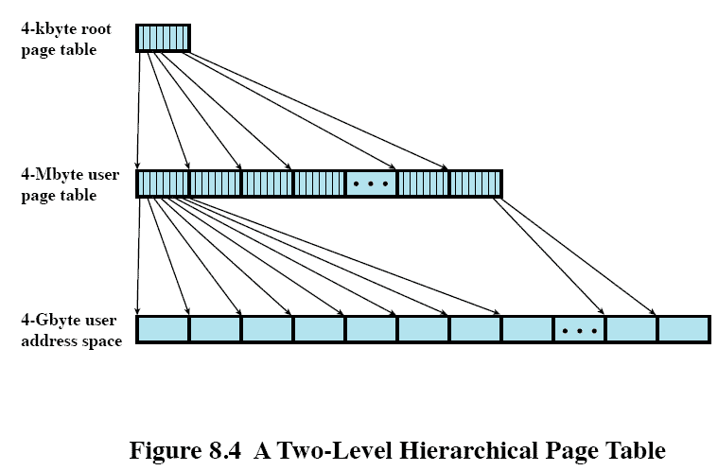
Two-Level Hierarchical Page Table
2¹⁰ entries, each PTE has 4 byte
2²⁰ entries, each PTE has 4 byte
2²⁰ pages, each page size is 2¹² byte
Notes:
Figure 8.4 shows an example of a two-level scheme typical for use with a
32-bit address. If we assume byte-level addressing and 4-kbyte (2 12 ) pages, then the
4-Gbyte (2 32 ) virtual address space is composed of 2 20 pages. If each of these pages
is mapped by a 4-byte page table entry, we can create a user page table composed of
2 20 PTEs requiring 4 Mbytes (2 22 ). This huge user page table, occupying 2 10 pages,
can be kept in virtual memory and mapped by a root page table with 2 10 PTEs occupying
4 Kbyte (2 12 ) of main memory.
19

Slide 20
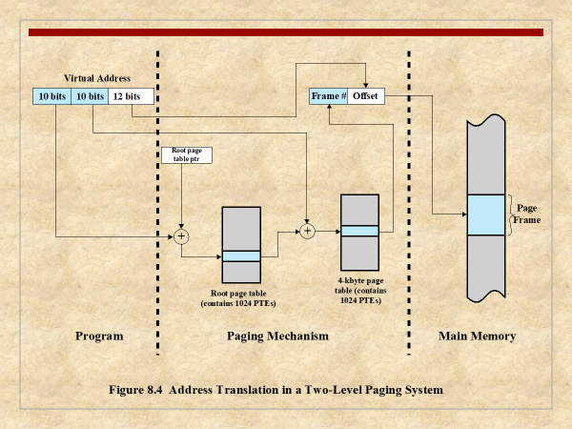

Slide 21


It indexes page table entries by frame number rather than by virtual page number. So it is called inverted.
For a physical memory size of 2m frames, the inverted page table contains 2m entries, so that the ith entry refers to frame i.
Page number portion of a virtual address is mapped into a hash value
Fixed proportion of real memory is used for the inverted table regardless of the number of processes or virtual pages supported
Notes:
INVERTED PAGE TABLE A drawback of the type of page tables that we have been
discussing is that their size is proportional to that of the virtual address space.
An alternative approach to the use of one or multiple-level page tables is the
use of an inverted page table structure. Variations on this approach are used on
the PowerPC, UltraSPARC, and the IA-64 architecture. An implementation of the
Mach operating system on the RT-PC also uses this technique.
In this approach, the page number portion of a virtual address is mapped into a
hash value using a simple hashing function. 1 The hash value is a pointer to the inverted
page table, which contains the page table entries. There is one entry in the inverted
page table for each real memory page frame rather than one per virtual page. Thus,
a fixed proportion of real memory is required for the tables regardless of the number
of processes or virtual pages supported. Because more than one virtual address may
map into the same hash table entry, a chaining technique is used for managing the
overflow. The hashing technique results in chains that are typically short—between
one and two entries. The page table’s structure is called inverted because it indexes
page table entries by frame number rather than by virtual page number.
21

Slide 22

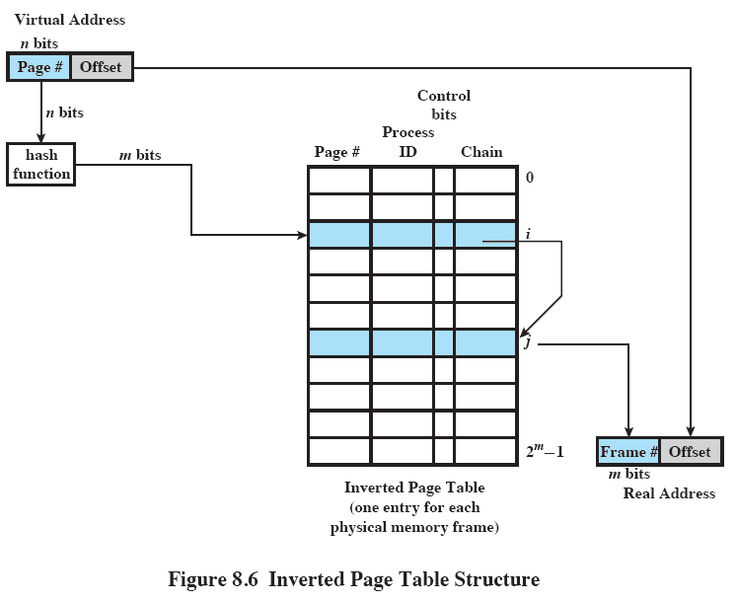
https://www.youtube.com/watch?v=Hgo89fGH1X0
Modulo function
Notes:
Figure 8.6 shows a typical implementation of the inverted page table approach.
For a physical memory size of 2 m frames, the inverted page table contains 2 m entries,
so that the ith entry refers to frame i .
In this example, the virtual address includes an n -bit page number, with n>m .
The hash function maps the n -bit page number into an m -bit quantity, which is used
to index into the inverted page table.
22

Slide 23
Translation Lookaside Buffer (TLB)
To overcome the effect of doubling the memory access time, most virtual memory schemes make use of a special high-speed cache called a translation lookaside buffer
Notes:
TRANSLATION LOOKASIDE BUFFER In principle, every virtual memory reference
can cause two physical memory accesses: one to fetch the appropriate page table
entry and one to fetch the desired data. Thus, a straightforward virtual memory
scheme would have the effect of doubling the memory access time. To overcome
this problem, most virtual memory schemes make use of a special high-speed cache
for page table entries, usually called a translation lookaside buffer (TLB) . This
cache functions in the same way as a memory cache (see Chapter 1 ) and contains
those page table entries that have been most recently used.
23

Slide 24
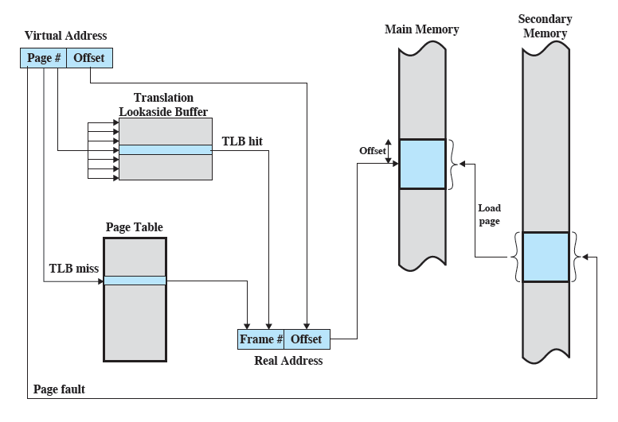
Use of a TLB
https://www.youtube.com/watch?v=95QpHJX55bM
Notes:
The organization of
the resulting paging hardware is illustrated in Figure 8.7 . Given a virtual address,
the processor will first examine the TLB. If the desired page table entry is present
( TLB hit ), then the frame number is retrieved and the real address is formed. If the
desired page table entry is not found ( TLB miss ), then the processor uses the page
number to index the process page table and examine the corresponding page table
entry. If the “present bit” is set, then the page is in main memory, and the processor
can retrieve the frame number from the page table entry to form the real address.
The processor also updates the TLB to include this new page table entry. Finally,
if the present bit is not set, then the desired page is not in main memory and a
memory access fault, called a page fault , is issued. At this point, we leave the realm
of hardware and invoke the operating system, which loads the needed page and
updates the page table.
24

Slide 25
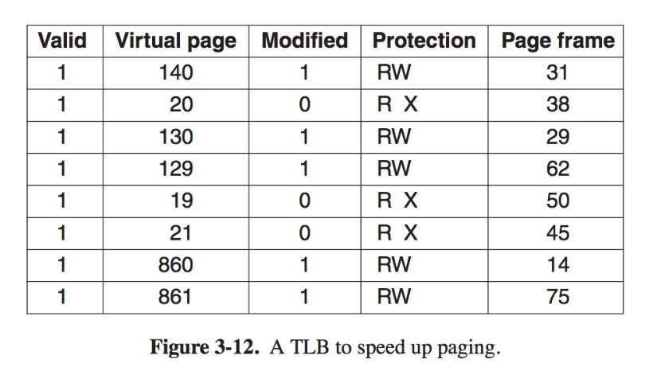
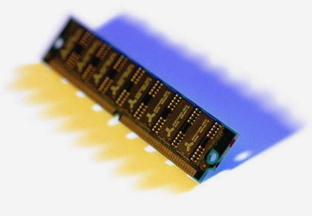
Associative Mapping
The TLB only contains some of the page table entries so we cannot simply index into the TLB based on page number
each TLB entry must include the page number as well as the complete page table entry
The processor is equipped with hardware that allows it to interrogate simultaneously a number of TLB entries to determine if there is a match on page number
Notes:
There are a number of additional details concerning the actual organization
of the TLB. Because the TLB contains only some of the entries in a full page table,
we cannot simply index into the TLB based on page number. Instead, each entry
in the TLB must include the page number as well as the complete page table entry.
The processor is equipped with hardware that allows it to interrogate simultaneously
a number of TLB entries to determine if there is a match on page number.
This technique is referred to as associative mapping and is contrasted with the direct
mapping, or indexing, used for lookup in the page table in Figure 8.9 . The design of
the TLB also must consider the way in which entries are organized in the TLB and
which entry to replace when a new entry is brought in. These issues must be considered
in any hardware cache design. This topic is not pursued here; the reader may
consult a treatment of cache design for further details (e.g., [STAL10]).
25

Slide 26
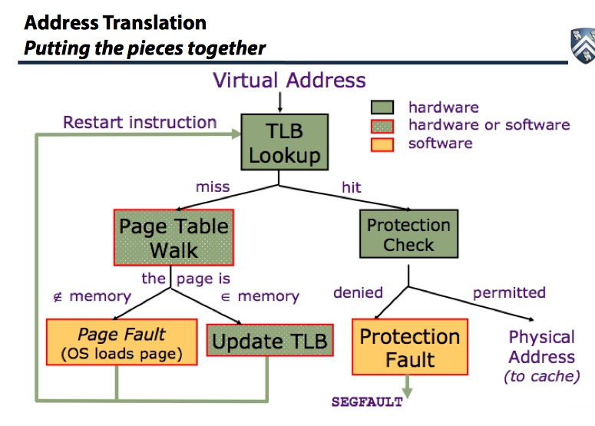

Slide 27
present bit
page
fault

Slide 28
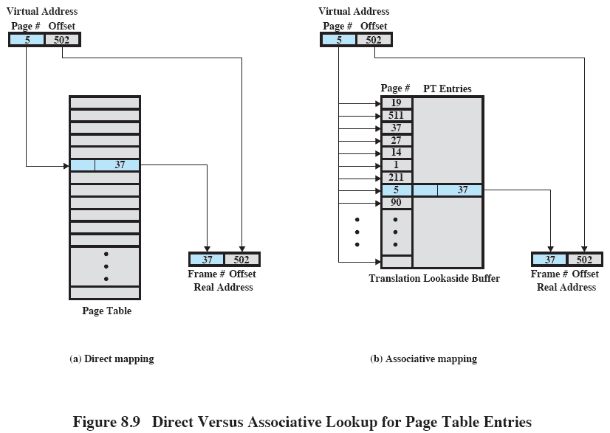
Direct Versus Associative Lookup
Notes:
Figure 8.9 Direct Versus Associative Lookup for Page Table Entries
This slide contrasts associative mapping with direct mappingor indexing, used for lookup in the page table.
The design of the TLB also must consider the way in which entries are organized in the TLB and which entry to replace when a new entry is brought in.
These issues must be considered in any hardware cache design.
28

Slide 29
Page Size
The smaller the page size, the lesser the amount of internal fragmentation
however, more pages are required per process
more pages per process means larger page tables
for large programs in a heavily multiprogrammed environment some portion of the page tables of active processes must be in virtual memory instead of main memory
DOUBLE PAGE FAULTS
the physical characteristics of most secondary-memory devices favor a larger page size for more efficient block transfer of data
Notes:
PAGE SIZE An important hardware design decision is the size of page to be used.
There are several factors to consider. One is internal fragmentation. Clearly, the
smaller the page size, the lesser is the amount of internal fragmentation. To optimize
the use of main memory, we would like to reduce internal fragmentation. On the
other hand, the smaller the page, the greater is the number of pages required per
process. More pages per process means larger page tables. For large programs in
a heavily multiprogrammed environment, this may mean that some portion of the
page tables of active processes must be in virtual memory, not in main memory.
Thus, there may be a double page fault for a single reference to memory: first to
bring in the needed portion of the page table and second to bring in the process page.
Another factor is that the physical characteristics of most secondary-memory devices,
which are rotational, favor a larger page size for more efficient block transfer of data.
29

Slide 30
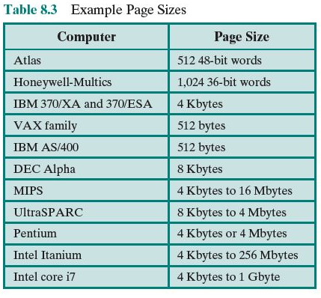
Notes:
Table 8.3 lists the page sizes used on some machines.
30

Slide 31
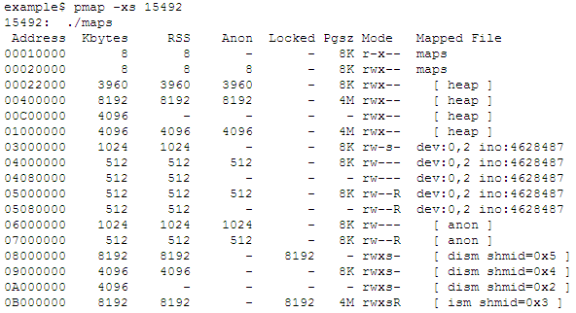
An example of multiple page sizes

Slide 32
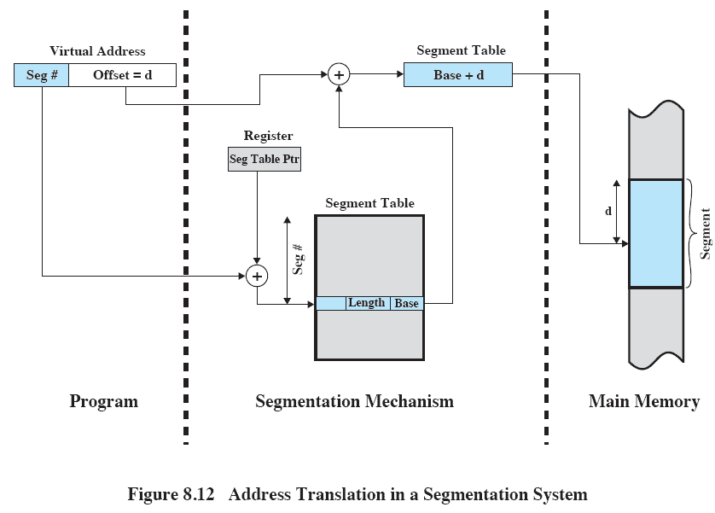
Segmentation: Address Translation
Notes:
The basic mechanism for reading a word from memory involves the translation
of a virtual, or logical, address, consisting of segment number and offset, into a physical
address, using a segment table. Because the segment table is of variable length,
depending on the size of the process, we cannot expect to hold it in registers. Instead,
it must be in main memory to be accessed. Figure 8.12 suggests a hardware implementation
of this scheme (note similarity to Figure 8.3 ). When a particular process
is running, a register holds the starting address of the segment table for that process.
The segment number of a virtual address is used to index that table and look up the
corresponding main memory address for the start of the segment. This is added to
the offset portion of the virtual address to produce the desired real address.
32

Slide 33
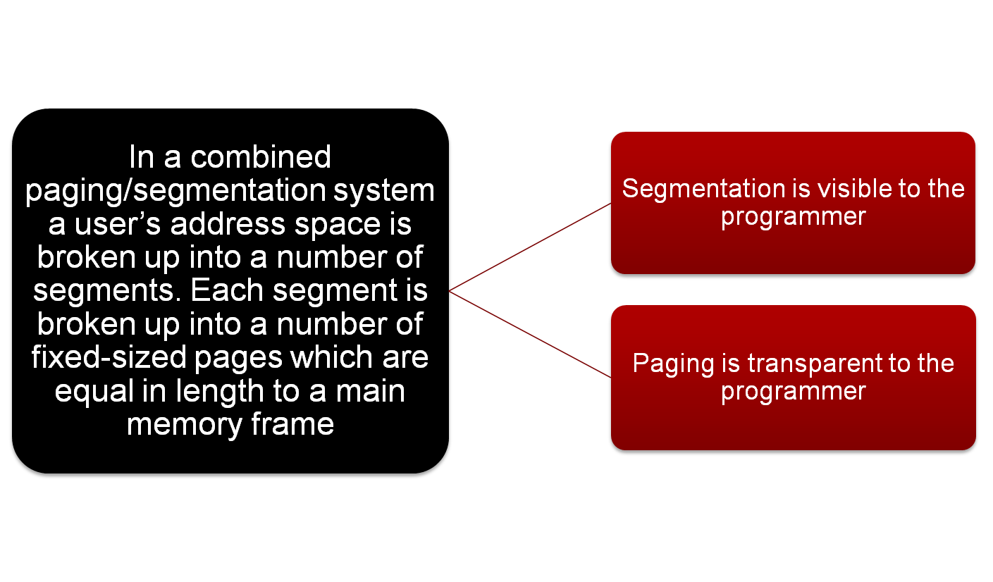
Combined Paging and Segmentation
Notes:
Combined Paging and Segmentation
Both paging and segmentation have their strengths. Paging, which is transparent
to the programmer, eliminates external fragmentation and thus provides efficient
use of main memory. In addition, because the pieces that are moved in and out of
main memory are of fixed, equal size, it is possible to develop sophisticated memory
management algorithms that exploit the behavior of programs, as we shall see.
Segmentation, which is visible to the programmer, has the strengths listed earlier,
including the ability to handle growing data structures, modularity, and support
for sharing and protection. To combine the advantages of both, some systems are
equipped with processor hardware and operating system software to provide both.
In a combined paging/segmentation system, a user’s address space is broken
up into a number of segments, at the discretion of the programmer. Each segment
is, in turn, broken up into a number of fixed-size pages, which are equal in length to
a main memory frame. If a segment has length less than that of a page, the segment
occupies just one page. From the programmer’s point of view, a logical address still
consists of a segment number and a segment offset. From the system’s point of view,
the segment offset is viewed as a page number and page offset for a page within the
specified segment.
33

Slide 34
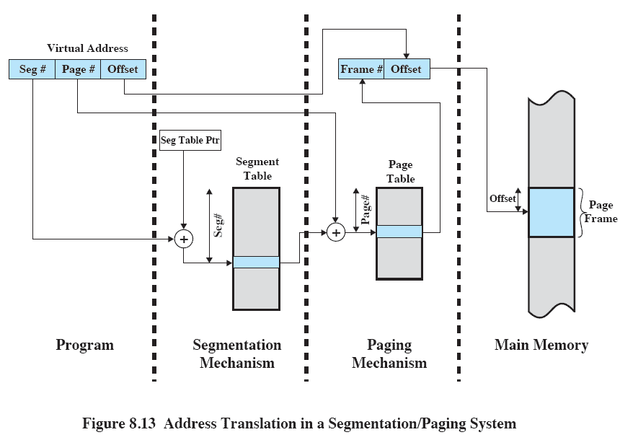
Address Translation
Notes:
Figure 8.13 suggests a structure to support combined paging/segmentation
(note similarity to Figure 8.5 ). Associated with each process is a segment table and
a number of page tables, one per process segment. When a particular process is
running, a register holds the starting address of the segment table for that process.
Presented with a virtual address, the processor uses the segment number portion to
index into the process segment table to find the page table for that segment. Then
the page number portion of the virtual address is used to index the page table and
look up the corresponding frame number. This is combined with the offset portion
of the virtual address to produce the desired real address.
34

Slide 35
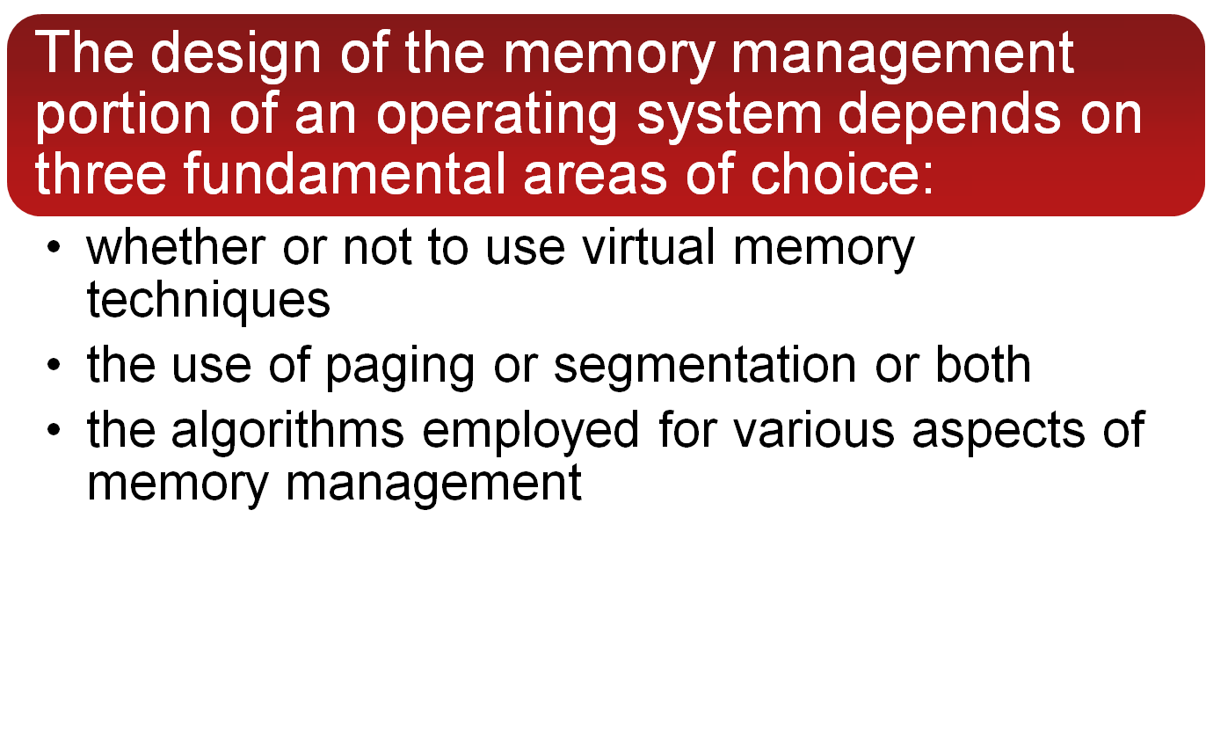
8.2 Operating System Software
https://www.youtube.com/watch?v=iCq8lCo6wzM
Notes:
The design of the memory management portion of an operating system depends on
three fundamental areas of choice:
• Whether or not to use virtual memory techniques
• The use of paging or segmentation or both
• The algorithms employed for various aspects of memory management
The choices made in the first two areas depend on the hardware platform available.
Thus, earlier UNIX implementations did not provide virtual memory because the
processors on which the system ran did not support paging or segmentation. Neither
of these techniques is practical without hardware support for address translation
and other basic functions.
Two additional comments about the first two items in the preceding list: First,
with the exception of operating systems for some of the older personal computers,
such as MS-DOS, and specialized systems, all important operating systems provide
virtual memory. Second, pure segmentation systems are becoming increasingly rare.
When segmentation is combined with paging, most of the memory management
issues confronting the operating system designer are in the area of paging. Thus,
we can concentrate in this section on the issues associated with paging.
The choices related to the third item are the domain of operating system software
and are the subject of this section.
35

Slide 36
PAGE FAULTS
We would like to minimize the rate at which page faults occur, because page faults cause considerable software overhead.
the I/O of loading data from disks to memory, and vice versa. (exchanging pages).
decide which resident page or pages to replace
Also, the operating system must schedule another process to run during the page I/O, causing a process switch.
https://www.youtube.com/watch?v=Rs4ECYOMY8A
https://www.youtube.com/watch?v=bShqyf-hDfg

Slide 37
PAGE FAULTS
Source: http://en.wikipedia.org/wiki/Page_fault
A page fault occurs when a program accesses a page that is mapped in the virtual address space, but not loaded in physical memory.
Minor Fault: If the page is loaded in memory at the time the fault is generated, but is not marked in the memory management unit as being loaded in memory, then it is called a minor or soft page fault.
Major Fault: If the page is not loaded in memory at the time the fault is generated, then it is called a major or hard page fault.

Slide 38
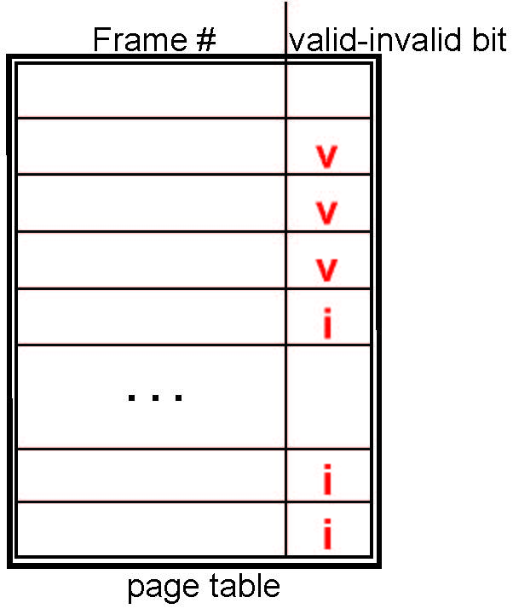
Valid-Invalid Bit
With each page table entry a valid–invalid bit is associated (v ⇒ in-memory – memory resident, i ⇒ not-in-memory)
Initially valid–invalid bit is set to i on all entries
Example of a page table snapshot:
During MMU address translation, if valid–invalid bit in page table entry is i ⇒ page fault

Slide 39
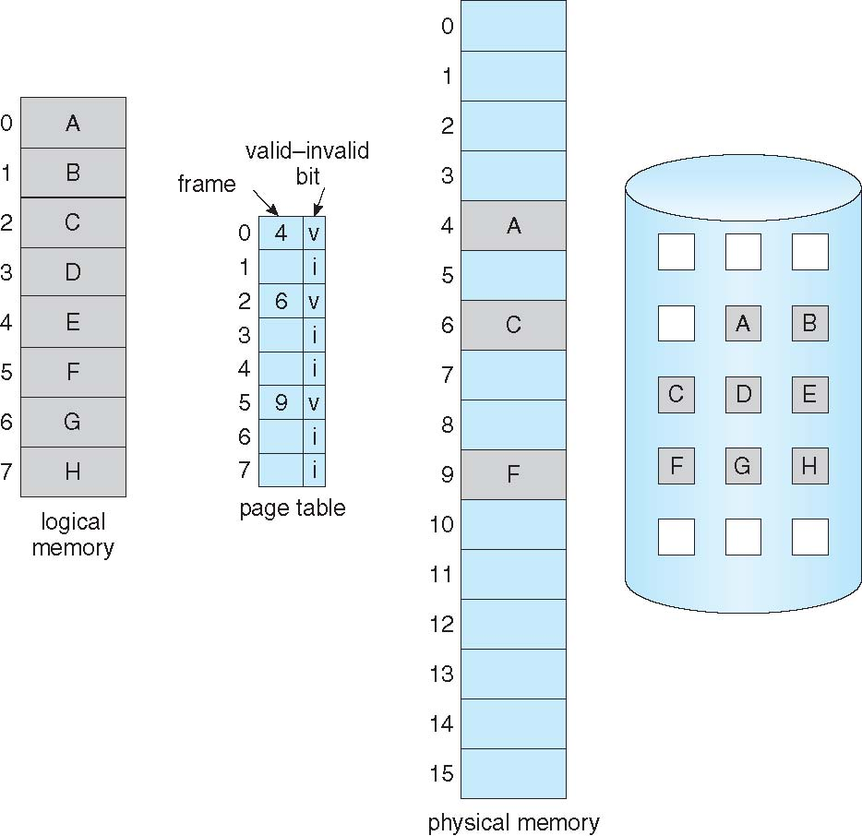
Page Table When Some Pages Are Not in Main Memory

Slide 40

Steps in Handling a Page Fault

Slide 41
Design issues relate to OS support for memory management
Fetch policy: Process pages can be brought in on demand, or a prepaging policy can be used, which clusters the input activity by bringing in a number of pages at once.
Replacement policy: When memory is full, a decision must be made as to which page or pages are to be replaced.
Resident set management: The OS must decide how much main memory to allocate to a particular process when that process is swapped in. This can be a static allocation made at process creation time, or it can change dynamically.
Cleaning policy: Modified process pages can be written out at the time of replacement, or a precleaning policy can be used, which clusters the output activity by writing out a number of pages at once.
Load control: Load control is concerned with determining the number of processes that will be resident in main memory at any given time.

Slide 42
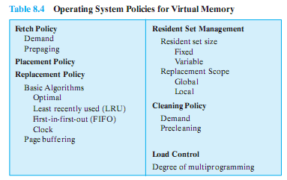
Objective: Minimize page faults
No definitive best policy
Notes:
We would like to minimize the rate at which page faults occur, because page faults cause considerable software overhead.
At a minimum, the overhead includes deciding which resident page or pages to replace,
and the I/O of exchanging pages.
Also, the operating system must schedule another process to run during the page I/O, causing a process switch.
In all of the areas referred to in Table 8.4, there is no definitive policy that works best.
The performance of any particular set of policies depends on
main memory size,
the relative speed of main and secondary memory,
the size and number of processes competing for resources,
and the execution behaviour of individual programs.
42

Slide 43

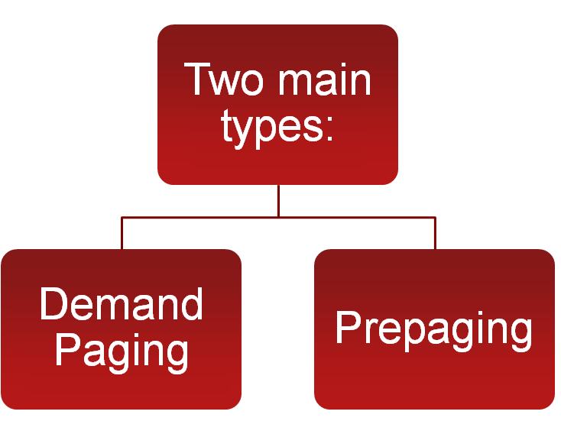


Determines when a page should be brought into memory
Notes:
The fetch policy determines when a page should be brought into main memory. The
two common alternatives are demand paging and prepaging.
43

Slide 44
Demand Paging
Demand Paging
only brings pages into main memory when a reference is made to a location on the page
many page faults when process is first started
principle of locality suggests that as more and more pages are brought in, most future references will be to pages that have recently been brought in, and page faults should drop to a very low level
Notes:
With demand paging ,
a page is brought into main memory only when a reference is made to a location on
that page. If the other elements of memory management policy are good, the following
should happen. When a process is first started, there will be a flurry of page
faults. As more and more pages are brought in, the principle of locality suggests that
most future references will be to pages that have recently been brought in. Thus,
after a time, matters should settle down and the number of page faults should drop
to a very low level.
44

Slide 45
Prepaging
Prepaging
pages other than the one demanded by a page fault are brought in
exploits the characteristics of most secondary memory devices
if pages of a process are stored contiguously in secondary memory it is more efficient to bring in a number of pages at one time
ineffective if extra pages are not referenced
Notes:
With prepaging , pages other than the one demanded by a page fault are
brought in. Prepaging exploits the characteristics of most secondary memory
devices, such as disks, which have seek times and rotational latency. If the pages of
a process are stored contiguously in secondary memory, then it is more efficient to
bring in a number of contiguous pages at one time rather than bringing them in one
at a time over an extended period. Of course, this policy is ineffective if most of the
extra pages that are brought in are not referenced.
The prepaging policy could be employed either when a process first starts up,
in which case the programmer would somehow have to designate desired pages, or
every time a page fault occurs. This latter course would seem preferable because
it is invisible to the programmer. However, the utility of prepaging has not been
established [MAEK87].
Prepaging should not be confused with swapping. When a process is swapped
out of memory and put in a suspended state, all of its resident pages are moved out.
When the process is resumed, all of the pages that were previously in main memory
are returned to main memory.
45

Slide 46
Placement Policy
https://www.youtube.com/watch?v=xRe-2rwzo6g&index=33&list=PLgre7dUq8DGKbtnlMuJPvPYlvLdXOC9uh
Determines where in real memory a process piece is to reside
Important design issue in a segmentation system
Paging or combined paging with segmentation placing is irrelevant because hardware performs functions with equal efficiency
For NUMA (nonuniform memory access) systems, the time for accessing a particular physical location varies with the distance between the processor and the memory module. The placement policy does have some performance impact.
Notes:
Placement Policy
The placement policy determines where in real memory a process piece is to reside.
In a pure segmentation system, the placement policy is an important design issue;
policies such as best-fit, first-fit, and so on, which were discussed in Chapter 7 , are
possible alternatives. However, for a system that uses either pure paging or paging
combined with segmentation, placement is usually irrelevant because the address
translation hardware and the main memory access hardware can perform their
functions for any page-frame combination with equal efficiency.
There is one area in which placement does become a concern, and this is a
subject of research and development. On a so-called nonuniform memory access
(NUMA) multiprocessor, the distributed, shared memory of the machine can be
referenced by any processor on the machine, but the time for accessing a particular
physical location varies with the distance between the processor and the memory
module. Thus, performance depends heavily on the extent to which data reside
close to the processors that use them [LARO92, BOLO89, COX89]. For NUMA
systems, an automatic placement strategy is desirable to assign pages to the memory
module that provides the best performance.
46

Slide 47
Replacement Policy
Important!
Deals with the selection of a page in main memory to be replaced when a new page must be brought in
objective is that the page that is removed be the page least likely to be referenced in the near future
The more elaborate the replacement policy the greater the hardware and software overhead to implement it
Notes:
Replacement Policy
In most operating system texts, the treatment of memory management includes a
section entitled “replacement policy,” which deals with the selection of a page in
main memory to be replaced when a new page must be brought in. This topic is
sometimes difficult to explain because several interrelated concepts are involved:
• How many page frames are to be allocated to each active process
• Whether the set of pages to be considered for replacement should be limited
to those of the process that caused the page fault or encompass all the page
frames in main memory
• Among the set of pages considered, which particular page should be selected
for replacement
We shall refer to the first two concepts as resident set management , which is dealt
with in the next subsection, and reserve the term replacement policy for the third
concept, which is discussed in this subsection.
The area of replacement policy is probably the most studied of any area of
memory management. When all of the frames in main memory are occupied and
it is necessary to bring in a new page to satisfy a page fault, the replacement policy
determines which page currently in memory is to be replaced. All of the policies
have as their objective that the page that is removed should be the page least likely
to be referenced in the near future. Because of the principle of locality, there is
often a high correlation between recent referencing history and near-future referencing
patterns. Thus, most policies try to predict future behavior on the basis of
past behavior. One trade-off that must be considered is that the more elaborate and
sophisticated the replacement policy, the greater will be the hardware and software
overhead to implement it.
47

Slide 48


We need to know the feature of frame locking before we go over the replacement algorithms
When a frame is locked the page currently stored in that frame may not be replaced
kernel of the OS as well as key control structures are held in locked frames
I/O buffers and time-critical areas may be locked into main memory frames
locking is achieved by associating a lock bit with each frame
Notes:
FRAME LOCKING One restriction on replacement policy needs to be mentioned
before looking at various algorithms: Some of the frames in main memory may be
locked. When a frame is locked, the page currently stored in that frame may not be
replaced. Much of the kernel of the OS, as well as key control structures, are held in
locked frames. In addition, I/O buffers and other time-critical areas may be locked
into main memory frames. Locking is achieved by associating a lock bit with each
frame. This bit may be kept in a frame table as well as being included in the current
page table.
48

Slide 49
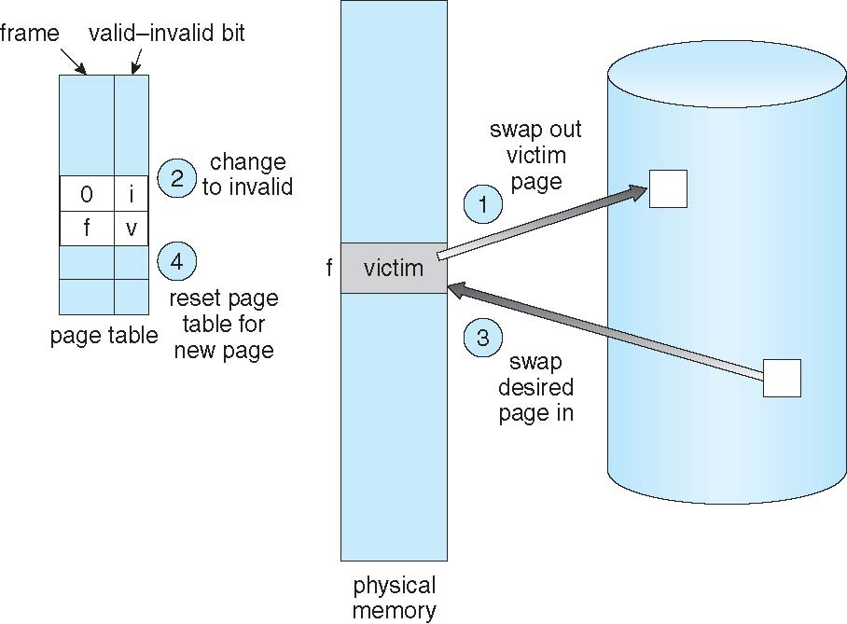
Page Replacement

Slide 50

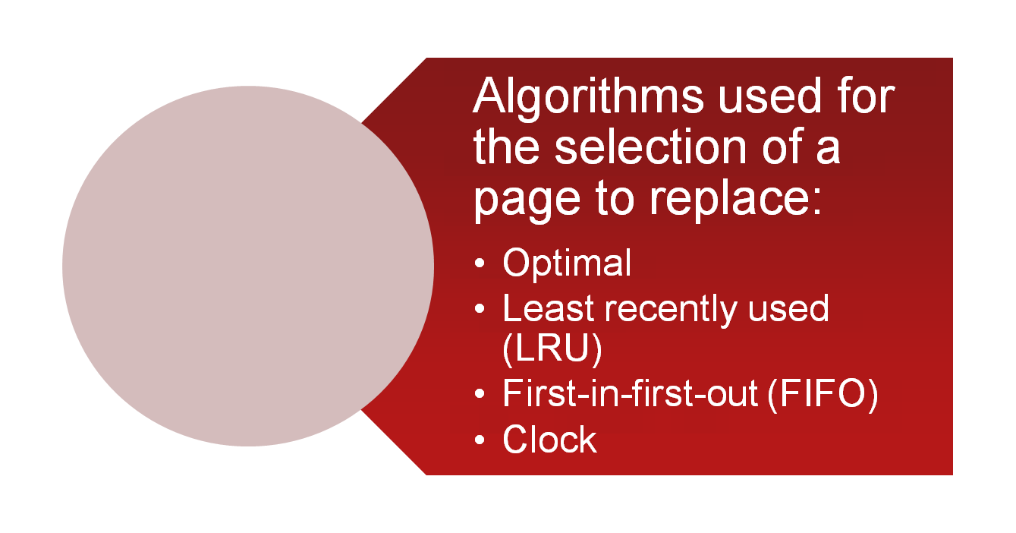
Notes:
BASIC ALGORITHMS Regardless of the resident set management strategy (discussed
in the next subsection), there are certain basic algorithms that are used for the
selection of a page to replace. Replacement algorithms that have been discussed in
the literature include
• Optimal
• Least recently used (LRU)
• First-in-first-out (FIFO)
• Clock
50

Slide 51

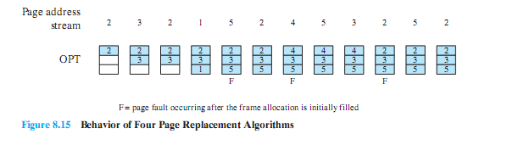
Selects the page for which the time to the next reference is the longest
Produces three page faults after the frame allocation has been filled
Notes:
The optimal policy selects for replacement that page for which the time to the next
reference is the longest. It can be shown that this policy results in the fewest number of
page faults [BELA66]. Clearly, this policy is impossible to implement, because it would
require the operating system to have perfect knowledge of future events. However, it
does serve as a standard against which to judge real-world algorithms.
Figure 8.15 gives an example of the optimal policy. The example assumes a
fixed frame allocation (fixed resident set size) for this process of three frames. The
execution of the process requires reference to five distinct pages. The page address
stream formed by executing the program is
2 3 2 1 5 2 4 5 3 2 5 2
which means that the first page referenced is 2, the second page referenced is 3, and
so on. The optimal policy produces three page faults after the frame allocation has
been filled.
51

Slide 52
Least Recently Used (LRU)
Replaces the page that has not been referenced for the longest time
By the principle of locality, this should be the page least likely to be referenced in the near future
Difficult to implement
one approach is to tag each page with the time of last reference
this requires a great deal of overhead
Notes:
The least recently used (LRU) policy replaces the page in memory that has
not been referenced for the longest time. By the principle of locality, this should
be the page least likely to be referenced in the near future. And, in fact, the LRU
policy does nearly as well as the optimal policy. The problem with this approach is
the difficulty in implementation. One approach would be to tag each page with the
time of its last reference; this would have to be done at each memory reference,
both instruction and data. Even if the hardware would support such a scheme, the
overhead would be tremendous. Alternatively, one could maintain a stack of page
references, again an expensive prospect.
52

Slide 53
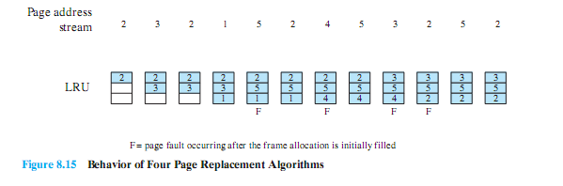
LRU Example
Notes:
Figure 8.15 shows an example of the behavior of LRU, using the same page
address stream as for the optimal policy example. In this example, there are four
page faults.
53

Slide 54
First-in-First-out (FIFO)
Treats page frames allocated to a process as a circular buffer
Pages are removed in round-robin style
simple replacement policy to implement
Page that has been in memory the longest is replaced
Notes:
The first-in-first-out (FIFO) policy treats the page frames allocated to a process
as a circular buffer, and pages are removed in round-robin style. All that is
required is a pointer that circles through the page frames of the process. This is
therefore one of the simplest page replacement policies to implement. The logic
behind this choice, other than its simplicity, is that one is replacing the page that
has been in memory the longest: A page fetched into memory a long time ago may
have now fallen out of use. This reasoning will often be wrong, because there will
often be regions of program or data that are heavily used throughout the life of a
program. Those pages will be repeatedly paged in and out by the FIFO algorithm.
54

Slide 55

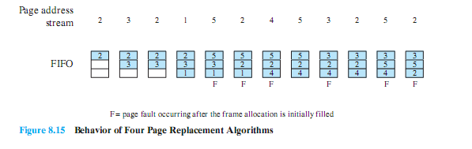
Notes:
Continuing our example in Figure 8.15 , the FIFO policy results in six page
faults. Note that LRU recognizes that pages 2 and 5 are referenced more frequently
than other pages, whereas FIFO does not.
Although the LRU policy does nearly as well as an optimal policy, it is difficult
to implement and imposes significant overhead. On the other hand, the FIFO
policy is very simple to implement but performs relatively poorly. Over the years,
operating system designers have tried a number of other algorithms to approximate
the performance of LRU while imposing little overhead. Many of these algorithms
are variants of a scheme referred to as the clock policy .
55

Slide 56
Clock Policy
Requires the association of an additional bit with each frame
referred to as the use bit
When a page is first loaded in memory or referenced, the use bit is set to 1
The set of frames is considered to be a circular buffer
Any frame with a use bit of 1 is passed over by the algorithm
If any of the frames in the buffer have a use bit of 0 at the beginning of this process, the first such frame encountered is chosen for replacement. If all of the frames have a use bit of 1, then the pointer will make one complete cycle through the buffer, setting all the use bits to 0, and stop at its original position, replacing the page in that frame.
Notes:
The simplest form of clock policy requires the association of an additional
bit with each frame, referred to as the use bit. When a page is first loaded into a
frame in memory, the use bit for that frame is set to 1. Whenever the page is subsequently
referenced (after the reference that generated the page fault), its use bit is
set to 1. For the page replacement algorithm, the set of frames that are candidates
for replacement (this process: local scope; all of main memory: global scope 5 ) is
considered to be a circular buffer, with which a pointer is associated. When a page
is replaced, the pointer is set to indicate the next frame in the buffer after the one
just updated. When it comes time to replace a page, the operating system scans
the buffer to find a frame with a use bit set to 0. Each time it encounters a frame
with a use bit of 1, it resets that bit to 0 and continues on. If any of the frames in
the buffer have a use bit of 0 at the beginning of this process, the first such frame
encountered is chosen for replacement. If all of the frames have a use bit of 1, then
the pointer will make one complete cycle through the buffer, setting all the use bits
to 0, and stop at its original position, replacing the page in that frame. We can see
that this policy is similar to FIFO, except that, in the clock policy, any frame with
a use bit of 1 is passed over by the algorithm. The policy is referred to as a clock
policy because we can visualize the page frames as laid out in a circle. A number of
operating systems have employed some variation of this simple clock policy (e.g.,
Multics [CORB68]).
56

Slide 57
Second-Chance (clock) Page-Replacement Algorithm

Slide 58
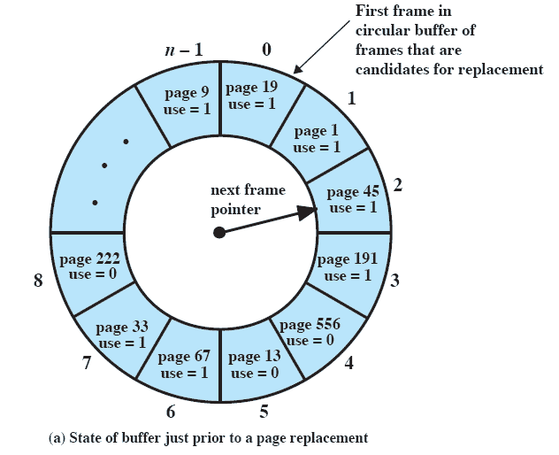
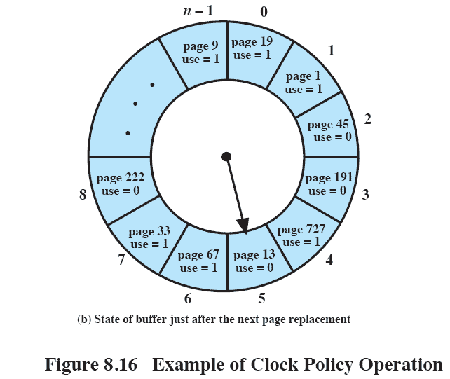
Clock Policy
Notes:
Continued on next slide
This figure (8.16) provides an example of the simple clock policy mechanism.
A circular buffer of n main memory frames is available for page replacement.
Just prior to the replacement of a page from the buffer with incoming page 727,
the next frame pointer points at frame 2, which contains page 45.
The clock policy is now executed.
Because the use bit for page 45 in frame 2 is equal to 1, this page is not replaced.
Instead, the use bit is set to zero and the pointer advances.
Similarly, page 191 in frame 3 is not replaced; its use bit is set to zero and the pointer advances.
In the next frame, frame 4, the use bit is set to 0.Therefore, page 556 is replaced with page 727.
The use bit is set to 1 for this frame and the pointer advances to frame 5, completing the page replacement procedure.
58

Slide 59
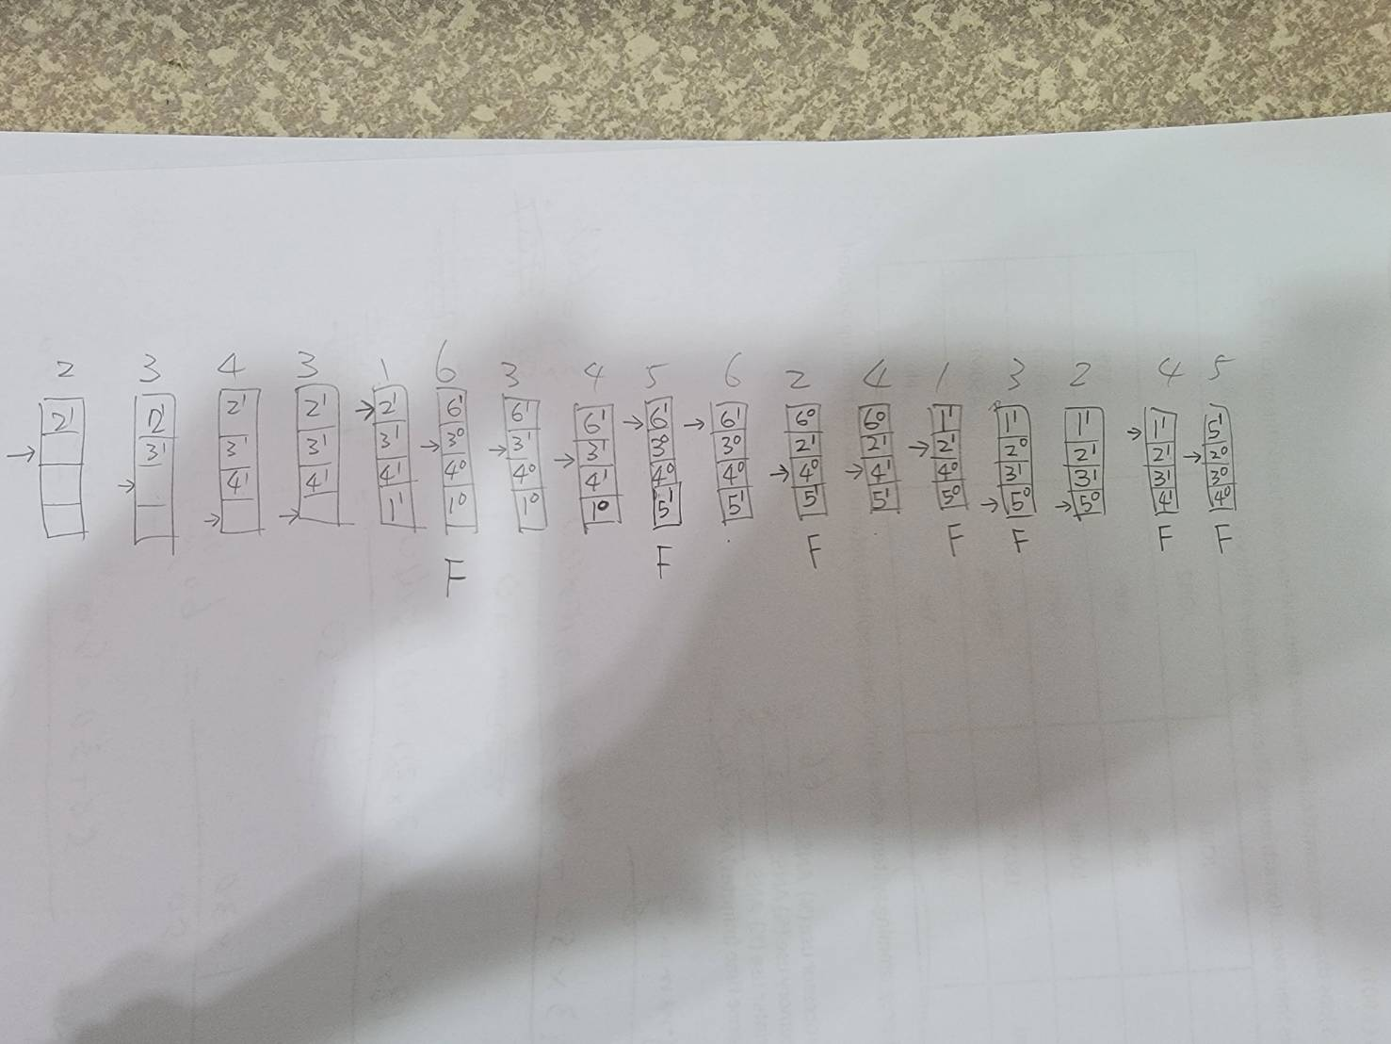

Slide 60

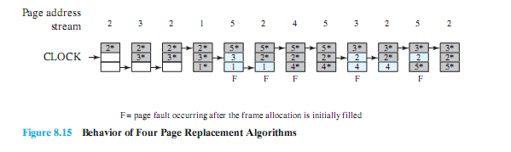
If page is already in memory,
mark use bit = 1, without moving pointer
Notes:
The behavior of the clock policy is illustrated in Figure 8.15 . The presence
of an asterisk indicates that the corresponding use bit is equal to 1, and the arrow
indicates the current position of the pointer. Note that the clock policy is adept at
protecting frames 2 and 5 from replacement.
60

Slide 61
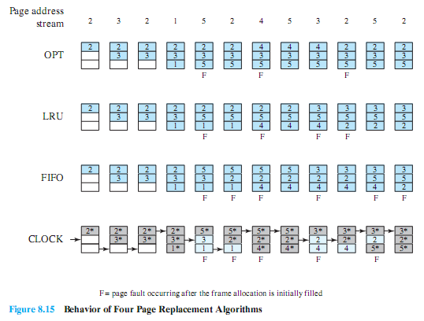
Combined Examples
Notes:
61

Slide 62

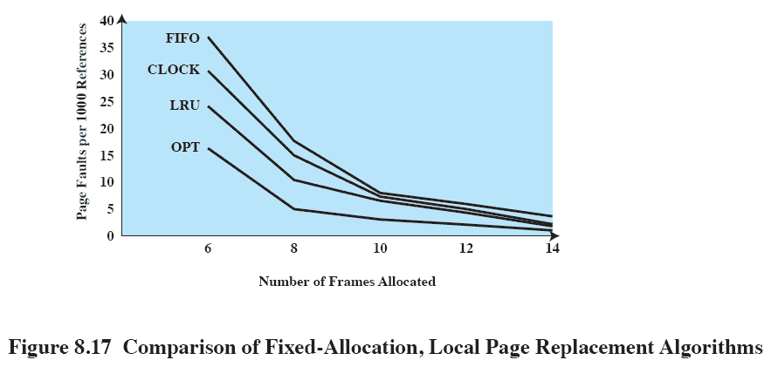
Assumptions: # of frames associated with each process is a fixed number.
Notes:
Figure 8.17 shows the results of an experiment reported in [BAER80], which
compares the four algorithms that we have been discussing; it is assumed that the
number of page frames assigned to a process is fixed. The results are based on the
execution of 0.25 °— 106 references in a FORTRAN program, using a page size of 256
words. Baer ran the experiment with frame allocations of 6, 8, 10, 12, and 14 frames.
The differences among the four policies are most striking at small allocations, with
FIFO being over a factor of 2 worse than optimal. All four curves have the same shape
as the idealized behavior shown in Figure 8.11b . In order to run efficiently, we would
like to be to the right of the knee of the curve (with a small page fault rate) while
keeping a small frame allocation (to the left of the knee of the curve). These two constraints
indicate that a desirable mode of operation would be at the knee of the curve.
The clock algorithm has also been compared to these other algorithms when
a variable allocation and either global or local replacement scope (see the following
discussion of replacement policy) is used [CARR81, CARR84]. The clock algorithm
was found to approximate closely the performance of LRU.
62

Slide 63
Modified Clock Algorithm
Add one “modify” bit (m), in additions to use bit (u).
When a page has been modified, it can not be replaced until it has been written into secondary memory.
Any frame will fall into one of the four categories:
u=0, m=0
u=0, m=1
u=1, m=0
u=1, m=1

Slide 64
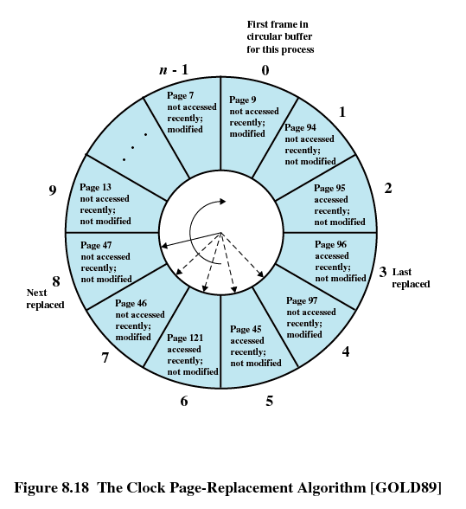
F | u | m
0 | 0 | 1
1 | 0 | 0
2 | 1 | 0
3 | 1 | 0
4 | 0 | 1
5 | 1 | 0
6 | 1 | 0
7 | 0 | 1
8 | 0 | 0
9 | 0 | 0
10 | 0 | 1

Slide 65
Replacement Order
Start at the current position of the pointer, during the first scan, make no change to the use bit. The first frame encountered with u=0 & m=0 is selected for replacement.
If step 1 fails, scan again, look for frame with u=0 & m=1. Set the use bit to 0 on each frame that is bypassed.
If step 2 fails again, the pointer should have returned to its original position and all of frames in the set will have u=0. Repeat step 1, then step for sure a frame will be found.

Slide 66
Two-handed Clock Algorithm
The reference (use) bit is set to one when the page is referenced for a read or write.
The fronthand sets the use bit to 0. The backhand sweeps sometimes after the fronthand. If the bit is still 0, then the page has not been referenced in the time interval. These pages are placed on a list to be paged out.
Two parameters determine the operation of the algorithm:
Scanrate: The rate which the two hands scan through the page list, in pages per second
Handspread: The gap between fronthand and backhand.

Slide 67
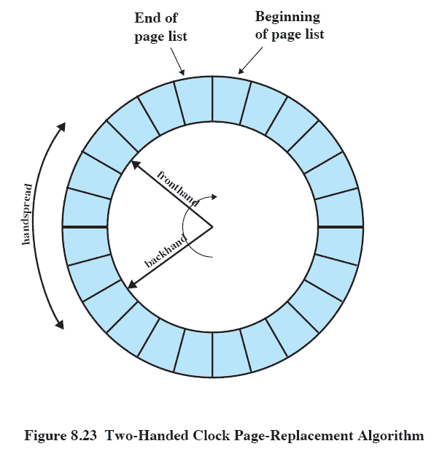
“Two Handed” Clock Page Replacement
Notes:
The page replacement algorithm used in SVR4 is a refinement of the
clock policy algorithm ( Figure 8.16 ) known as the two-handed clock algorithm
( Figure 8.23 ). The algorithm uses the reference bit in the page table entry for each
page in memory that is eligible (not locked) to be swapped out. This bit is set to 0
when the page is first brought in and set to 1 when the page is referenced for a read
or write. One hand in the clock algorithm, the fronthand, sweeps through the pages
on the list of eligible pages and sets the reference bit to 0 on each page. Sometime
later, the backhand sweeps through the same list and checks the reference bit. If
the bit is set to 1, then that page has been referenced since the fronthand swept by;
these frames are ignored. If the bit is still set to 0, then the page has not been referenced
in the time interval between the visit by fronthand and backhand; these pages
are placed on a list to be paged out.
Two parameters determine the operation of the algorithm:
• Scanrate: The rate at which the two hands scan through the page list, in pages
per second
• Handspread: The gap between fronthand and backhand
These two parameters have default values set at boot time based on the
amount of physical memory. The scanrate parameter can be altered to meet changing
conditions. The parameter varies linearly between the values slowscan and fastscan
(set at configuration time) as the amount of free memory varies between the values
lotsfree and minfree . In other words, as the amount of free memory shrinks, the
clock hands move more rapidly to free up more pages. The handspread parameter
determines the gap between the fronthand and the backhand and therefore, together
with scanrate, determines the window of opportunity to use a page before it is
swapped out due to lack of use.
67

Slide 68
When freemem < lotsfree
Scanrate = slowscan, while lostsfree < freemem < (lotsfree + deficit)
Scanrate = 0,
while freemem > (lotsfree + deficit)
lotsfree
+
deficit

Slide 69
Scan Rate
Scanning Algorithm
● Kick-off scanner when Free memory is lower than (lotsfree)
● The scan rate starts at slowscan (e.g 100 pages/sec)
The scan rate increases when free memory continues to decrease, up to fastscan (e.g. 8192 pages / sec)
● Limits:
– Max # of pages /sec that swap device can handle
– How much CPU should be used for scanning

Slide 70
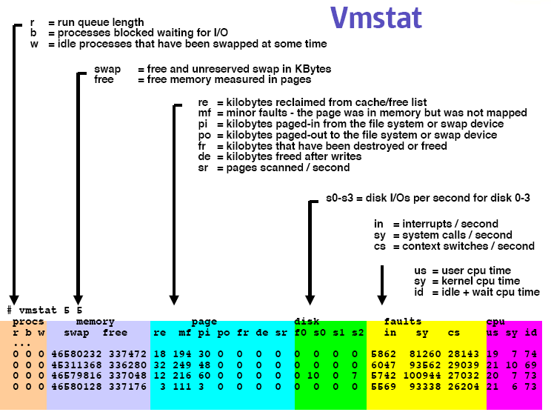

Slide 72
Objective: Minimize page faults
No definitive best policy
Notes:
We would like to minimize the rate at which page faults occur, because page faults cause considerable software overhead.
At a minimum, the overhead includes deciding which resident page or pages to replace,
and the I/O of exchanging pages.
Also, the operating system must schedule another process to run during the page I/O, causing a process switch.
In all of the areas referred to in Table 8.4, there is no definitive policy that works best.
The performance of any particular set of policies depends on
main memory size,
the relative speed of main and secondary memory,
the size and number of processes competing for resources,
and the execution behaviour of individual programs.
72

Slide 73
Page-Buffering Algorithms
Keep a pool of free frames, always
Then frame available when needed, not found at fault time
Read page into free frame and select victim to evict and add to free pool
When convenient, evict victim
Possibly, keep list of modified pages
When backing store otherwise idle, write pages there and set to non-dirty
Possibly, keep free frame contents intact and note what is in them
If referenced again before reused, no need to load contents again from disk
Generally useful to reduce penalty if wrong victim frame selected

Slide 74

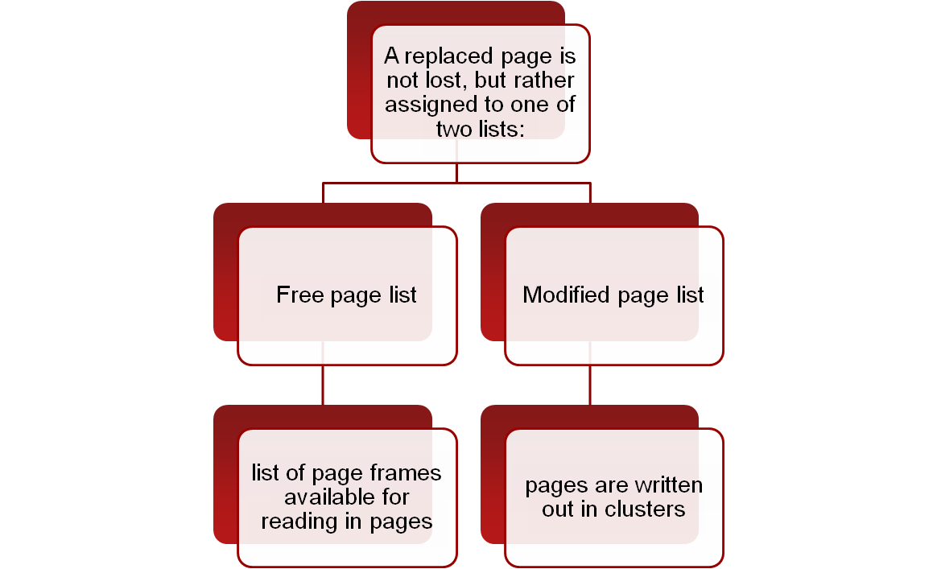
To improve performance, a replaced page is not lost but rather is assigned to one of two lists:
the free page list if not modified,
the modified page list if it has.
Note that the page is not physically moved about in main memory; instead, the entry in the page table for this page is removed and placed in either the free or modified page list.
Notes:
PAGE BUFFERING Although LRU and the clock policies are superior to FIFO,
they both involve complexity and overhead not suffered with FIFO. In addition,
there is the related issue that the cost of replacing a page that has been modified is
greater than for one that has not, because the former must be written back out to
secondary memory.
An interesting strategy that can improve paging performance and allow
the use of a simpler page replacement policy is page buffering. The VAX VMS
approach is representative. The page replacement algorithm is simple FIFO. To
improve performance, a replaced page is not lost but rather is assigned to one of
two lists: the free page list if the page has not been modified, or the modified page
list if it has. Note that the page is not physically moved about in main memory;
instead, the entry in the page table for this page is removed and placed in either the
free or modified page list.
The free page list is a list of page frames available for reading in pages. VMS
tries to keep some small number of frames free at all times. When a page is to be
read in, the page frame at the head of the list is used, destroying the page that was
there. When an unmodified page is to be replaced, it remains in memory and its
page frame is added to the tail of the free page list. Similarly, when a modified page
is to be written out and replaced, its page frame is added to the tail of the modified
page list.
The important aspect of these maneuvers is that the page to be replaced
remains in memory. Thus if the process references that page, it is returned to the
resident set of that process at little cost. In effect, the free and modified page lists act
as a cache of pages. The modified page list serves another useful function: Modified
pages are written out in clusters rather than one at a time. This significantly reduces
the number of I/O operations and therefore the amount of disk access time.
A simpler version of page buffering is implemented in the Mach operating
system [RASH88]. In this case, no distinction is made between modified and
unmodified pages.
74

Slide 75
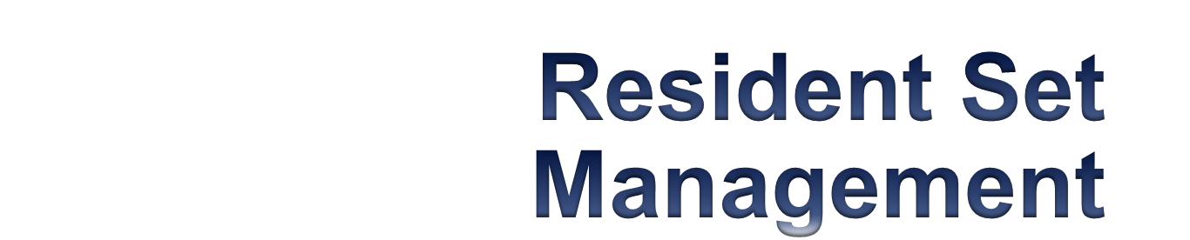
The OS must decide how many pages to bring into main memory
the smaller the amount of memory allocated to each process, the more processes can reside in memory
small number of pages loaded increases page faults
beyond a certain size, further allocations of pages will not effect the page fault rate
Notes:
With paged virtual memory, it is not necessary and indeed
may not be possible to bring all of the pages of a process into main memory to
prepare it for execution. Thus, the operating system must decide how many pages to
bring in, that is, how much main memory to allocate to a particular process. Several
factors come into play:
• The smaller the amount of memory allocated to a process, the more processes
that can reside in main memory at any one time. This increases the probability
that the operating system will find at least one ready process at any given time
and hence reduces the time lost due to swapping.
• If a relatively small number of pages of a process are in main memory, then,
despite the principle of locality, the rate of page faults will be rather high (see
Figure 8.11b ).
• Beyond a certain size, additional allocation of main memory to a particular
process will have no noticeable effect on the page fault rate for that process
because of the principle of locality.
75

Slide 76
Resident Set Size
Fixed-allocation
Variable-allocation
gives a process a fixed number of frames in main memory within which to execute
when a page fault occurs, one of the pages of that process must be replaced
allows the number of page frames allocated to a process to be varied over the lifetime of the process
Notes:
With these factors in mind, two sorts of policies are to be found in contemporary
operating systems. A fixed-allocation policy gives a process a fixed number of
frames in main memory within which to execute. That number is decided at initial
load time (process creation time) and may be determined based on the type of process
(interactive, batch, type of application) or may be based on guidance from the
programmer or system manager. With a fixed-allocation policy, whenever a page
fault occurs in the execution of a process, one of the pages of that process must be
replaced by the needed page.
A variable-allocation policy allows the number of page frames allocated to a
process to be varied over the lifetime of the process. Ideally, a process that is suffering
persistently high levels of page faults, indicating that the principle of locality
only holds in a weak form for that process, will be given additional page frames
to reduce the page fault rate; whereas a process with an exceptionally low page
fault rate, indicating that the process is quite well behaved from a locality point of
view, will be given a reduced allocation, with the hope that this will not noticeably
increase the page fault rate. The use of a variable-allocation policy relates to the
concept of replacement scope, as explained in the next subsection.
The variable-allocation policy would appear to be the more powerful one.
However, the difficulty with this approach is that it requires the operating system to
assess the behavior of active processes. This inevitably requires software overhead
in the operating system and is dependent on hardware mechanisms provided by the
processor platform.
76

Slide 77

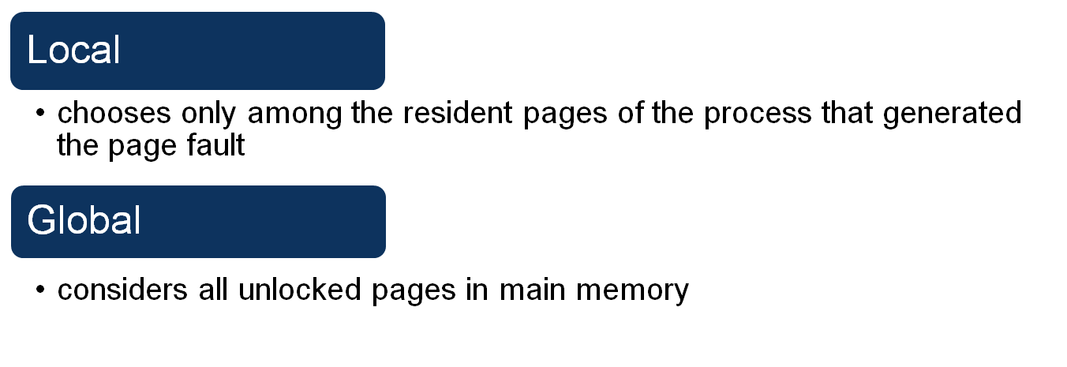
The scope of a replacement strategy can be categorized as globalor local
both types are activated by a page fault when there are no free page frames
Notes:
The scope of a replacement strategy can be categorized as
global or local. Both types of policies are activated by a page fault when there are no
free page frames. A local replacement policy chooses only among the resident pages
of the process that generated the page fault in selecting a page to replace. A global
replacement policy considers all unlocked pages in main memory as candidates for
replacement, regardless of which process owns a particular page. While it happens
that local policies are easier to analyze, there is no convincing evidence that they
perform better than global policies, which are attractive because of their simplicity
of implementation and minimal overhead [CARR84, MAEK87].
77

Slide 78
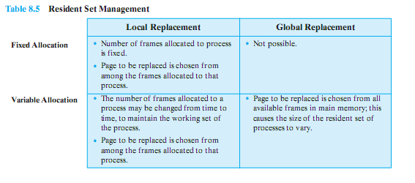
Resident Set Management Summary
Notes:
78

Slide 79

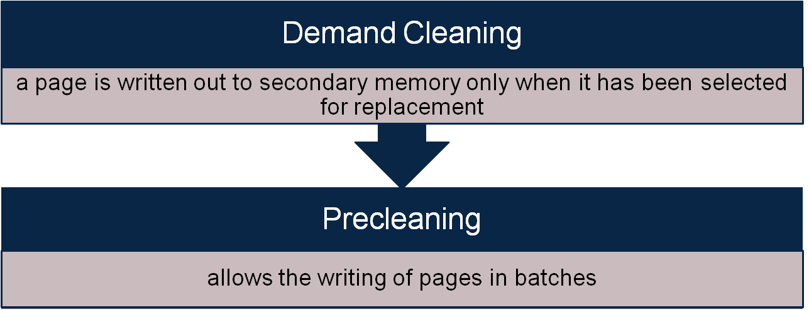
Concerned with determining when a modified page should be written out to secondary memory
Notes:
A cleaning policy is the opposite of a fetch policy; it is concerned with determining
when a modified page should be written out to secondary memory. Two common
alternatives are demand cleaning and precleaning. With demand cleaning , a page is
written out to secondary memory only when it has been selected for replacement.
A precleaning policy writes modified pages before their page frames are needed so
that pages can be written out in batches.
There is a danger in following either policy to the full. With precleaning, a
page is written out but remains in main memory until the page replacement algorithm
dictates that it be removed. Precleaning allows the writing of pages in batches,
but it makes little sense to write out hundreds or thousands of pages only to find
that the majority of them have been modified again before they are replaced. The
transfer capacity of secondary memory is limited and should not be wasted with
unnecessary cleaning operations.
79

Slide 80
What cleaning police to use?
There is a danger in following either policy to the full.
Precleaning allows the writing of pages in batches, but it makes little sense to write out hundreds or thousands of pages only to find that the majority of them have been modified again before they are replaced.
Demand cleaning may minimize page writes, but it means that a process that suffers a page fault may have to wait for two page transfers before it can be unblocked. This may decrease processor utilization the application processes.

Slide 81
Better Cleaning Policy
A better approach incorporates page buffering.
Clean only pages that are replaceable, but decouple the cleaning and replacement operations.
First, identify a set of pages that can be replaced, then place them on two lists: modified and unmodified.
The pages on the modified list can periodically be written out in batches and moved to the unmodified list. A page on the unmodified list is either reclaimed if it is referenced or lost when its frame is assigned to another page.

Slide 82
Too many processes:
Load Control
Determines the number of processes that will be resident in main memory
multiprogramming level
Critical in effective memory management
Too few processes, many occasions when all processes will be blocked and much time will be spent in swapping
Too many processes will lead to thrashing
Notes:
Load control is concerned with determining the number of processes that will be resident
in main memory, which has been referred to as the multiprogramming level. The
load control policy is critical in effective memory management. If too few processes
are resident at any one time, then there will be many occasions when all processes
are blocked, and much time will be spent in swapping. On the other hand, if too
many processes are resident, then, on average, the size of the resident set of each
process will be inadequate and frequent faulting will occur. The result is thrashing.
82

Slide 83

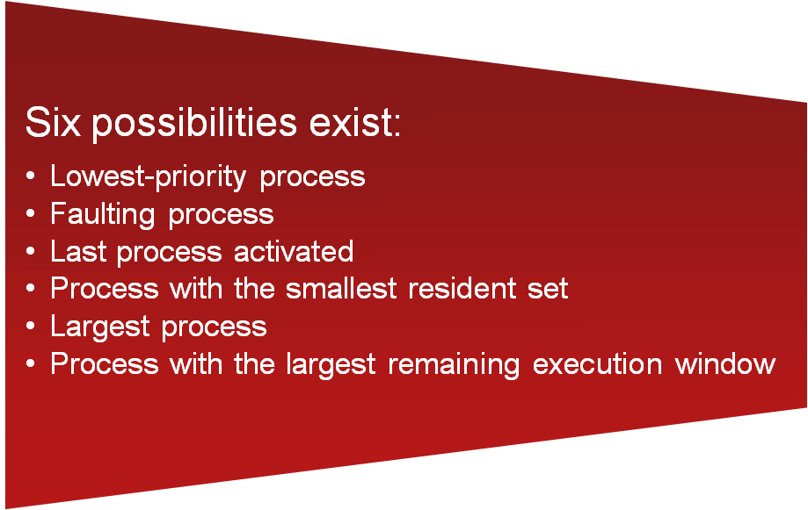
If the degree of multiprogramming is to be reduced, one or more of the currently resident processes must be swapped out
Notes:
If the degree of multiprogramming is to be reduced, one
or more of the currently resident processes must be suspended (swapped out).
[CARR84] lists six possibilities:
• Lowest-priority process: This implements a scheduling policy decision and is
unrelated to performance issues.
• Faulting process: The reasoning is that there is a greater probability that the
faulting task does not have its working set resident, and performance would
suffer least by suspending it. In addition, this choice has an immediate payoff
because it blocks a process that is about to be blocked anyway and it eliminates
the overhead of a page replacement and I/O operation.
• Last process activated: This is the process least likely to have its working set
resident.
• Process with the smallest resident set: This will require the least future effort
to reload. However, it penalizes programs with strong locality.
• Largest process: This obtains the most free frames in an overcommitted
memory, making additional deactivations unlikely soon.
• Process with the largest remaining execution window: In most process scheduling
schemes, a process may only run for a certain quantum of time before
being interrupted and placed at the end of the Ready queue. This approximates
a shortest-processing-time-first scheduling discipline.
83

Slide 84

8.3 Unix
Intended to be machine independent so its memory management schemes will vary
early Unix: variable partitioning with no virtual memory scheme
current implementations of UNIX and Solaris make use of paged virtual memory
Notes:
Because UNIX is intended to be machine independent, its memory management
scheme will vary from one system to the next. Earlier versions of UNIX simply used
variable partitioning with no virtual memory scheme. Current implementations of
UNIX and Solaris make use of paged virtual memory.
In SVR4 and Solaris, there are actually two separate memory management
schemes.
84

Slide 85


Notes:
The paging system provides a virtual memory capability that allocates
page frames in main memory to processes and also allocates page frames to disk
block buffers. Although this is an effective memory management scheme for user
processes and disk I/O, a paged virtual memory scheme is less suited to managing
the memory allocation for the kernel. For this latter purpose, a kernel memory
allocator is used.
85

Slide 86

The kernel generates and destroys small tables and buffers frequently during the course of execution, each of which requires dynamic memory allocation.
Most of these blocks are significantly smaller than typical page sizes (therefore paging would be inefficient)
Allocations and free operations must be made as fast as possible
For SVR4, a modification of
the buddy system is used.
Notes:
The kernel generates and destroys small tables and buffers frequently during the course of execution, each of which requires dynamic memory allocation.
Examples include:
• The pathname translation routing may allocate a buffer to copy a pathname from user space.
• The allocb() routine allocates STREAMS buffers of arbitrary size.
• Many UNIX implementations allocate zombie structures to retain exit status and resource usage information about deceased processes.
• In SVR4 and Solaris, the kernel allocates many objects (such as proc structures, vnodes, and file descriptor blocks) dynamically when needed.
Most of these blocks are significantly smaller than the typical machine page size,
therefore the paging mechanism would be inefficient for dynamic kernel memory allocation.
For SVR4, a modification of the buddy system is used.
86

Slide 87
Linux Memory Management
Shares many characteristics with UNIX
Is quite complex
Two main aspects
process virtual memory
kernel memory allocation
Notes:
Linux shares many of the characteristics of the memory management schemes of
other UNIX implementations but has its own unique features. Overall, the Linux
memory management scheme is quite complex [DUBE98]. In this section, we give
a brief overview of the two main aspects of Linux memory management: process
virtual memory and kernel memory allocation.

Slide 88
Linux Virtual Memory
Three level page table structure:
Page directory
process has a single page directory
each entry points to one page of the page middle directory
must be in main memory for an active process
Page middle directory
may span multiple pages
each entry points to one page in the page table
Page table
may also span multiple pages
each entry refers to one virtual page of the process
Notes:
Linux makes use of a three-level page table
structure, consisting of the following types of tables (each individual table is the size
of one page):
• Page directory: An active process has a single page directory that is the size
of one page. Each entry in the page directory points to one page of the page
middle directory. The page directory must be in main memory for an active
process.
Page middle directory: The page middle directory may span multiple pages.
Each entry in the page middle directory points to one page in the page table.
• Page table: The page table may also span multiple pages. Each page table
entry refers to one virtual page of the process.

Slide 89
Notes:
To use this three-level page table structure, a virtual address in Linux is viewed
as consisting of four fields ( Figure 8.23 ). The leftmost (most significant) field is used
as an index into the page directory. The next field serves as an index into the page
middle directory. The third field serves as an index into the page table. The fourth
field gives the offset within the selected page of memory.
The Linux page table structure is platform independent and was designed to
accommodate the 64-bit Alpha processor, which provides hardware support for
three levels of paging. With 64-bit addresses, the use of only two levels of pages on
the Alpha would result in very large page tables and directories. The 32-bit Pentium/
x86 architecture has a two-level hardware paging mechanism. The Linux software
accommodates the two-level scheme by defining the size of the page middle directory
as one. Note that all references to an extra level of indirection are optimized
away at compile time, not at run time. Therefore, there is no performance overhead
for using generic three-level design on platforms which support only two levels in
hardware.

Slide 90
Linux Page Replacement
Prior to 2.6.28: Based on the clock algorithm
(Use bit + Modify bit)
The use bit is replaced with an 8-bit age variable
incremented each time the page is accessed
Linux periodically sweeps through the global page pool, decrements the age bits
a page with an age of 0 is an “old” page that has not been referenced in some time and is the best candidate for replacement
A form of Clock policy/ LRU policy
Notes:
Prior to Linux release 2.6.28, the Linux page
replacement algorithm was based on the clock algorithm described in Section 8.2 (see
Figure 8.15). In the simple clock algorithm, a use bit and a modify bit are associated
with each page in main memory. In the Linux scheme, the use bit was replaced with an
8-bit age variable. Each time that a page is accessed, the age variable is incremented.
In the background, Linux periodically sweeps through the global page pool and
decrements the age variable for each page as it rotates through all the pages in main
memory. A page with an age of 0 is an “old” page that has not been referenced in
some time and is the best candidate for replacement. The larger the value of age, the
more frequently a page has been used in recent times and the less eligible it is for
replacement. Thus, the Linux algorithm was a form of least frequently used policy.

Slide 91
Linux Page Replacement
One problem with the older algorithm is that the periodic sweeps through the page pool consumes increasing amounts of processor time for increasingly large memories.
Beginning with Linux release 2.6.28: a new algorithm, referred to as a split LRU algorithm.
The new algorithm makes use of two flags added to each page table entry: PG_active and PG_referenced. The entire physical memory is divided into different “zones” in Linux based on their address.
Notes:
Prior to Linux release 2.6.28, the Linux page
replacement algorithm was based on the clock algorithm described in Section 8.2 (see
Figure 8.15). In the simple clock algorithm, a use bit and a modify bit are associated
with each page in main memory. In the Linux scheme, the use bit was replaced with an
8-bit age variable. Each time that a page is accessed, the age variable is incremented.
In the background, Linux periodically sweeps through the global page pool and
decrements the age variable for each page as it rotates through all the pages in main
memory. A page with an age of 0 is an “old” page that has not been referenced in
some time and is the best candidate for replacement. The larger the value of age, the
more frequently a page has been used in recent times and the less eligible it is for
replacement. Thus, the Linux algorithm was a form of least frequently used policy.

Slide 92
Notes:
We can summarize the steps involved in page management as follows (Figure 8.24):
1. The first time a page on the inactive list is accessed, the PG_referenced flag
is set.
2. The next time that page is accessed, it is moved to the active list. That is, it
takes two accesses for a page to be declared active. More precisely, it takes two
accesses in different scans for a page to become active.
3. If the second access doesn’t happen soon enough, PG_referenced is reset.
4. Similarly, for active pages, two timeouts are required to move the page to the
inactive list.
Pages on the inactive list are then available for page replacement, using an
LRU type of algorithm.

Slide 93
Kernel Memory Allocation
Kernel memory capability manages physical main memory page frames
primary function is to allocate and deallocate frames for user virtual memory management
A buddy algorithm is used so that memory for the kernel can be allocated and deallocated in units of one or more pages.
Notes:
The Linux kernel memory capability manages physical main memory page frames.
Its primary function is to allocate and deallocate frames for particular uses. Possible
owners of a frame include user-space processes (i.e., the frame is part of the virtual
memory of a process that is currently resident in real memory), dynamically allocated
kernel data, static kernel code, and the page cache.
The foundation of kernel memory allocation for Linux is the page allocation
mechanism used for user virtual memory management. As in the virtual memory
scheme, a buddy algorithm is used so that memory for the kernel can be allocated
and deallocated in units of one or more pages. Because the minimum amount of
memory that can be allocated in this fashion is one page, the page allocator alone
would be inefficient because the kernel requires small short-term memory chunks
in odd sizes. To accommodate these small chunks, Linux uses a scheme known as
slab allocation [BONW94] within an allocated page. On a Pentium/x86 machine, the
page size is 4 Kbytes, and chunks within a page may be allocated of sizes 32, 64, 128,
252, 508, 2,040, and 4,080 bytes.
The slab allocator is relatively complex and is not examined in detail here; a
good description can be found in [VAHA96]. In essence, Linux maintains a set of
linked lists, one for each size of chunk. Chunks may be split and aggregated in a
manner similar to the buddy algorithm and moved between lists accordingly.

Slide 94



vmstat: Reports Virtual Memory Statistics

Slide 95



Slide 96

Describe exactly how, in general, a virtual address generated by the CPU is translated into a physical main memory address.
b. What physical address, if any, would each of the following virtual addresses correspond to? (Do not try to handle any page faults, if any.)
(i) 1,052 (ii) 2,221 (iii) 5,499
Notes:
96
The Linux page replacement algorithm is
based on the clock algorithm described in Section 8.2 (see Figure 8.16 ). In the
simple clock algorithm, a use bit and a modify bit are associated with each page
in main memory. In the Linux scheme, the use bit is replaced with an 8-bit age
variable. Each time that a page is accessed, the age variable is incremented. In
the background, Linux periodically sweeps through the global page pool and
decrements the age variable for each page as it rotates through all the pages
in main memory. A page with an age of 0 is an “old” page that has not been
referenced in some time and is the best candidate for replacement. The larger
the value of age, the more frequently a page has been used in recent times and
the less eligible it is for replacement. Thus, the Linux algorithm is a form of least
frequently used policy.
96

Slide 97
Answer
a. Split binary address into virtual page number and offset; use VPN as index into page table; extract page frame number; concatenate offset to get physical memory address
b. (i) 1052 = 1024 + 28 maps to VPN 1 in PFN 7, (7 × 1024+28 = 7196)
(ii) 2221 = 2 ´ 1024 + 173 maps to VPN 2, page fault
(iii) 5499 = 5 ´ 1024 + 379 maps to VPN 5 in PFN 0, (0 ´ 1024+379 = 379)
Notes:
97
The Linux page replacement algorithm is
based on the clock algorithm described in Section 8.2 (see Figure 8.16 ). In the
simple clock algorithm, a use bit and a modify bit are associated with each page
in main memory. In the Linux scheme, the use bit is replaced with an 8-bit age
variable. Each time that a page is accessed, the age variable is incremented. In
the background, Linux periodically sweeps through the global page pool and
decrements the age variable for each page as it rotates through all the pages
in main memory. A page with an age of 0 is an “old” page that has not been
referenced in some time and is the best candidate for replacement. The larger
the value of age, the more frequently a page has been used in recent times and
the less eligible it is for replacement. Thus, the Linux algorithm is a form of least
frequently used policy.
97

Slide 98
Q 3
Consider a paged logical address space (composed of 32 pages of 2 Kbytes each) mapped into a 1-Mbyte physical memory space.
a. What is the format of the processor’s logical address?
b. What is the length and width of the page table (disregarding the “access rights” bits)?
c. What is the effect on the page table if the physical memory space is reduced by half? into a single page?
Notes:
98
The Linux page replacement algorithm is
based on the clock algorithm described in Section 8.2 (see Figure 8.16 ). In the
simple clock algorithm, a use bit and a modify bit are associated with each page
in main memory. In the Linux scheme, the use bit is replaced with an 8-bit age
variable. Each time that a page is accessed, the age variable is incremented. In
the background, Linux periodically sweeps through the global page pool and
decrements the age variable for each page as it rotates through all the pages
in main memory. A page with an age of 0 is an “old” page that has not been
referenced in some time and is the best candidate for replacement. The larger
the value of age, the more frequently a page has been used in recent times and
the less eligible it is for replacement. Thus, the Linux algorithm is a form of least
frequently used policy.
98

Slide 99
A 3
a.
page number (5) + offset (11)
b. 32 entries, each entry is 9 bits wide.
1 MB / 2 KB = 2²⁰/2¹¹ = 2⁹
c. If total number of entries stays at 32 and the page size does not change, then each entry becomes 8 bits wide.
Notes:
99
The Linux page replacement algorithm is
based on the clock algorithm described in Section 8.2 (see Figure 8.16 ). In the
simple clock algorithm, a use bit and a modify bit are associated with each page
in main memory. In the Linux scheme, the use bit is replaced with an 8-bit age
variable. Each time that a page is accessed, the age variable is incremented. In
the background, Linux periodically sweeps through the global page pool and
decrements the age variable for each page as it rotates through all the pages
in main memory. A page with an age of 0 is an “old” page that has not been
referenced in some time and is the best candidate for replacement. The larger
the value of age, the more frequently a page has been used in recent times and
the less eligible it is for replacement. Thus, the Linux algorithm is a form of least
frequently used policy.
99

Slide 100
Q4
Consider the following string of page references 7, 0, 1, 2, 0, 3, 0, 4, 2, 3, 0, 3, 2.
Complete a figure similar to Figure 8.14, showing the frame allocation for:
A. Clock
B. Optimal (assume the page reference string continues with 1, 2, 0, 1, 7, 0, 1)
List the total number of page faults and the miss rate for each policy. Count page faults only after all frames have been initialized.

Slide 101

A4
Clock: page faults = 6 miss rate = 60%
OPT: page faults = 3 miss rate = 30%

Slide 102
A5
A process contains eight virtual pages on disk and is assigned a fixed allocation of four page frames in main memory. The following page trace occurs:
1, 0, 2, 2, 1, 7, 6, 7, 0, 1, 2, 0, 3, 0, 4, 5, 1, 5, 2, 4, 5, 6, 7, 6, 7, 2, 4, 2, 7, 3, 3, 2, 3
Show the successive pages residing in the four frames using the LRU replacement policy. Compute the hit ratio in main memory. Assume the frames are initially empty.
Repeat part (a) for the FIFO replacement policy.
Compare the two hit ratios and comment on the effectiveness of using FIFO to approximate LRU with respect to this particular trace.

Slide 103

A5

Slide 104

Q6
Consider a simple segmentation system that has the following segment table: For each of the following logical addresses (seg #, offset) , determine the physical address or indicate if a segment fault occurs:
0, 198
2, 156
1, 530
3, 444
0, 222

Slide 105
A6
a. Segment 0 starts at location 660. With the offset, we have a
physical address of 660 + 198 = 858
b. 222 + 156 = 378
c. Segment 1 has a length of 422 bytes, so this address triggers a
segment fault.
d. 996 + 444 = 1440
e. 660 + 222 = 882

